Slide 1



Welcome!
Class will be starting shortly.
We will be testing audio a few minutes before class starts
Have questions? Ask in the chat room – click on purple tab in lower right corner and then click the chat bubble
Notes:
Here is the first slide.

Slide 2


Can you hear me?
Let me know in the chat room if you can hear me.
Notes:
Here another one.

Slide 3
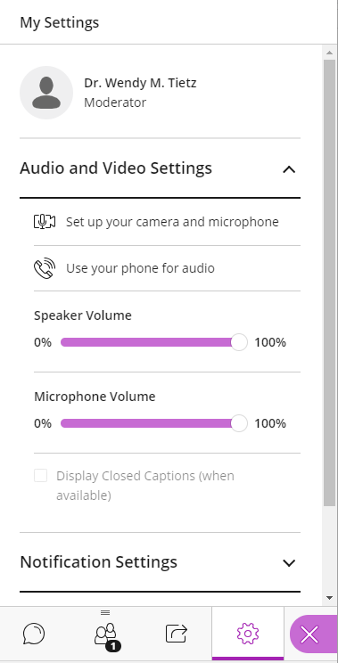
You can use your phone for audio…
Your name
Open the Collaborate panel in lower right corner (click on purple icon)
Click on Settings in lower right corner
Click on “Use your phone for audio”. You will be given a phone number and PIN code.

Slide 4


Please hold questions until the end
…unless your question is related to audio

