Slide 1
How should Canada Dry account for the lawsuit filed against it because its ginger ale allegedly does not contain ginger root?

Slide 2
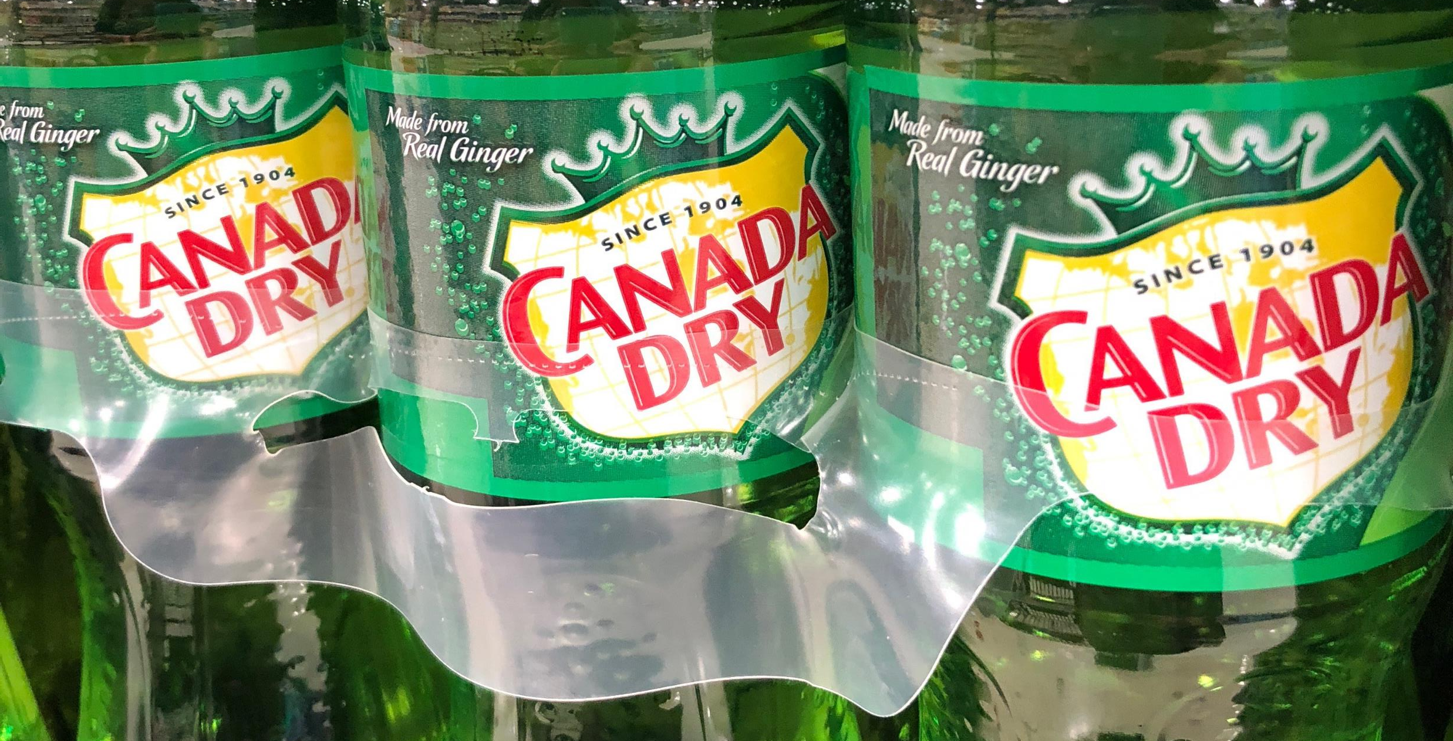

Keurig Dr Pepper and Canada Dry
Lawsuit filed by a woman in New York
Claims that Canada Dry ginger ale does not contain enough ginger root to be a healthy alternative to soda

Slide 3
Question 1
What is a contingent liability?

Slide 4
Question 2
What are the three potential accounting treatments for a contingent liability?

Slide 5
Question 3
In your opinion, how do you think Keurig Dr Pepper/Canada Dry will treat this contingent liability from an accounting standpoint?

Slide 6
Question Recap
What is a contingent liability?
What are the three potential accounting treatments for a contingent liability?
In your opinion, how do you think Keurig Dr Pepper/Canada Dry will treat this contingent liability from an accounting standpoint?

Slide 7
For additional news stories to use in the accounting classroom, see the
Accounting in the Headlines blog at http://accountingintheheadlines.com/
Questions or comments?
Dr. Wendy Tietz at wtietz@kent.edu

