Slide 1
Will the costs of converting UPS trucks from diesel to electric be capitalized or expensed?

Slide 2
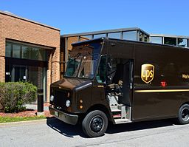
UPS converting diesel-fueled delivery vehicles to be all-electric
In New York City, UPS is working on technology to convert 1,500 (66%) of its diesel-fueled delivery trucks to electric-fueled by 2020
Working prototype planned for sometime in 2018
Benefits of all-electric include elimination of harmful emissions, noise, and dependence on fossil fuels

Slide 3
Question 1
What is the difference between capitalizing an expenditure versus expensing that expenditure?

Slide 4
Question 2
What information would you need to be able to determine if UPS should capitalize or expense the cost of converting the trucks to be all-electric?

Slide 5
Question 3
Do you think UPS will capitalize or expense the cost of converting to electric vehicles?

Slide 6
Question Recap
What is the difference between capitalizing an expenditure versus expensing that expenditure?
What information would you need to be able to determine if UPS should capitalize or expense the cost of converting the trucks to be all-electric?
Do you think UPS will capitalize or expense the cost of converting to electric vehicles?

Slide 7
For additional news stories to use in the accounting classroom, see the
Accounting in the Headlines blog at http://accountingintheheadlines.com/
Questions or comments?
Dr. Wendy Tietz at wtietz@kent.edu

