Slide 1
What impact did Toys “R” Us debt have on its bankruptcy?

Slide 2
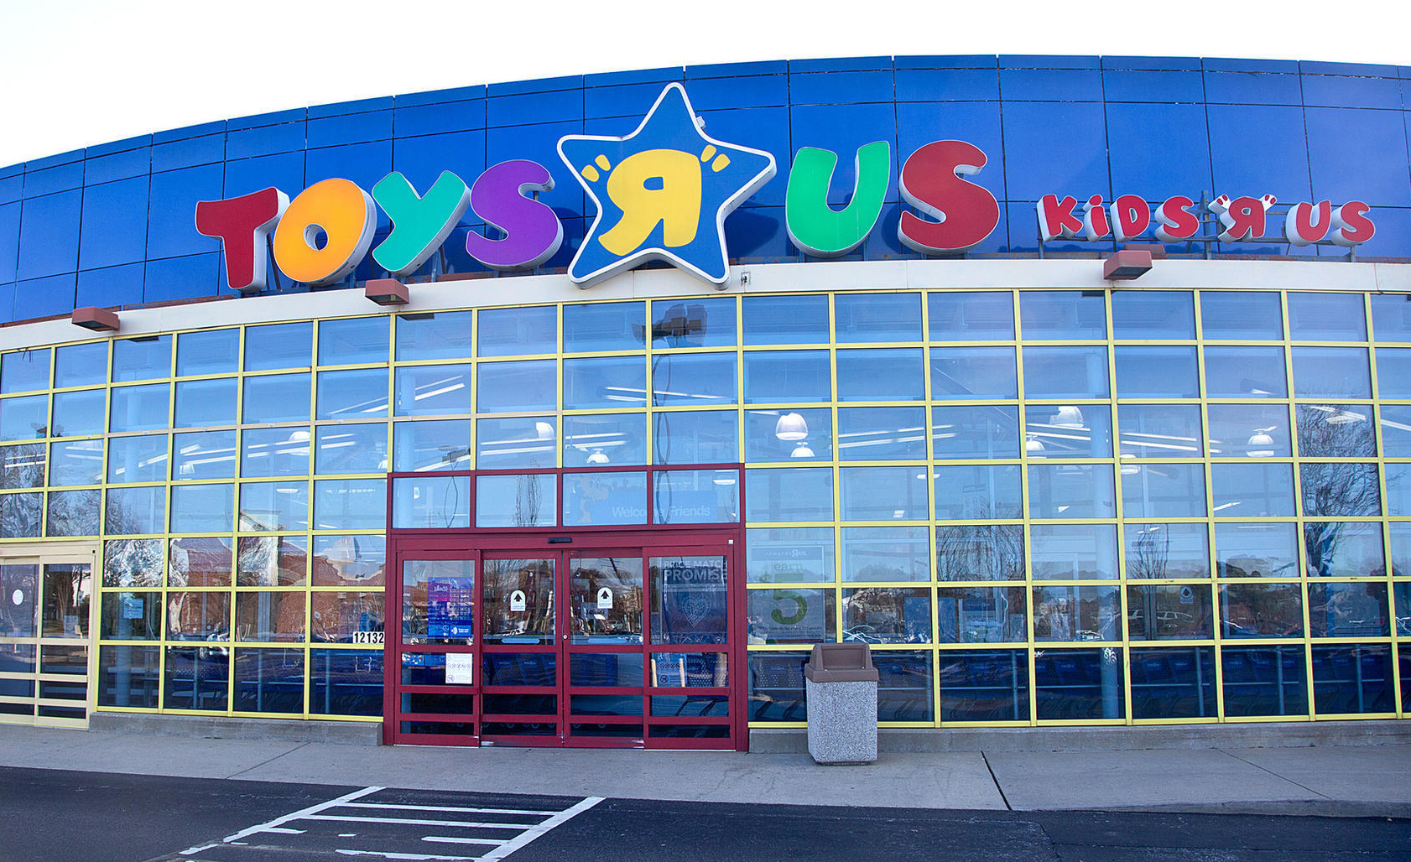
Toys “R” Us closing all US stores in 2018
$5 billion in debt
Spending $400 million per year for interest
Sales revenue $11.2 billion per year before takeover in 2005; Sales in most recent year $11.1 billion
Net loss for 2017 was approximately $953 million
Did not have cash in 2017 to make upgrades to technology and its stores

Slide 3
Question 1
Did Toys “R” Us have declining sales revenues over the past 13 years since it was taken private?

Slide 4
Question 2
Why might the private equity buyers have chosen to issue bonds (debt) in 2005 to purchase Toys “R” Us rather than issue stock?

Slide 5
Question 3
People often claim that Toys “R” Us was a victim of online retailers such as Amazon.com. Do you agree? What do you think is the major reason that Toys “R” Us had to file for bankruptcy?

Slide 6
Question Recap
Did Toys “R” Us have declining sales revenues over the past 13 years since it was taken private?
Why might the private equity buyers have chosen to issue bonds (debt) in 2005 to purchase Toys “R” Us rather than issue stock?
People often claim that Toys “R” Us was a victim of online retailers such as Amazon.com. Do you agree? What do you think is the major reason that Toys “R” Us had to file for bankruptcy?

Slide 7
For additional news stories to use in the accounting classroom, see the
Accounting in the Headlines blog at http://accountingintheheadlines.com/
Questions or comments?
Dr. Wendy Tietz at wtietz@kent.edu

