Slide 1
Wait! Why is the bank debiting my account to decrease it? Isn’t that backwards?
Notes:
In this short video, we are going to talk about why a bank will debit your bank account to decrease it when the debit-credit rules state that assets are decreased with a credit.

Slide 2
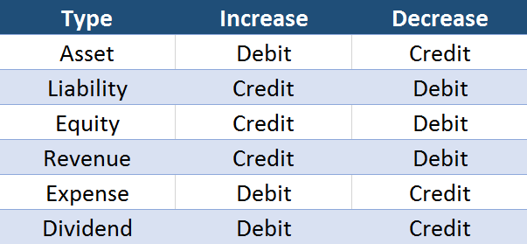
Debit-credit rules summary
Notes:
Just to review, here is a summary of the debit-credit rules. Note that assets are increased by debits and assets are decreased by credits. The opposite is true for liabilities – liabilities are increased by credits and decreased by debits.

Slide 3

Say you open a bank account with $100…
You have an asset, CASH
Debit-credit rule: Assets are increased by debits.
You would debit this account when you:
  Make a deposit
  Earn interest
Debit-credit rule: Assets are decreased by credits.
You would credit this account when you:
  Make a cash withdrawal
  Write a check
  Pay service charges
Notes:
Let’s go through an example now. Say you open a bank account by depositing $100. You have an asset, CASH. The debit-credit rules state that assets are increased by debits. You would debit your account when you make a deposit or earn interest, for example. The debit-credit rules also state that assets are decreased by credits. You would credit your cash account when you make a cash withdrawal, write a check, or pay bank service charges.

Slide 4

Now let’s think about this same transaction from the bank’s standpoint…
Hint: It is a mirror image of the transaction from the individual’s standpoint.
Notes:
Now let’s think about this same transaction from the bank’s standpoint. Hint: The accounting for this transaction will be a mirror image of the same transaction from the bank account owner’s standpoint.

Slide 5
The bank opens a customer account by accepting a $100 deposit…
Question: What type of account is this for the bank?
  Answer: It is a LIABILITY – the bank owes the customer the $100 deposited
Notes:
Back to our example now – the bank opens a customer account by accepting a $100 deposit. So here’s a question – What type of account is this for the bank? Answer: This account is a LIABILITY for the bank – the bank owes the customer the $100 that the customer deposited.

Slide 6
The bank opens a customer account by accepting a $100 deposit…
Debit-credit rule: Liabilities are increased by credits.
The bank will credit this account when it:
  Accepts a customer deposit
  Pays interest on the account
Debit-credit rule: Liabilities are decreased by debits.
The bank will debit this account when it:
  Disburses cash to the customer
  Pays a check that is written by the customer
  Deducts service charges from the account
Notes:
The debit-credit rules state that Liabilities are increased by credits. The bank will credit this account when it accepts a customer deposit or pays interest on the account, for example. Liabilities are decreased by debits. The bank will debit this account when it disburses cash to the customer, pays a check that is written by the customer, or deducts its service charges from the account.

Slide 7
To summarize
When CASH is an asset, it is debited to increase it and credited to decrease it.
When a bank accepts cash as a deposit into a customer’s bank account, the bank has a LIABILITY that it will credit to increase that customer’s account.
Notes:
To summarize, then, when cash is an asset, it is debited to increase it and credited to decrease it. When a bank accepts cash as a deposit into a customer’s bank account, the bank has a liability that it will credit to increase that customer’s account. That’s it – so that is the reason why the bank’s debit and credits seem to be backwards from what is on your bank statement.

Slide 8

For additional news stories to use in the accounting classroom, see the
Accounting in the Headlines blog at http://accountingintheheadlines.com
Questions or comments?
Contact Dr. Wendy Tietz at wtietz@kent.edu
Notes:
Thanks for watching!

