Slide 1
Does each
Subway $5 Footlong cost the franchisee more than $5?
Original blog post link on January 31, 2018

Slide 2
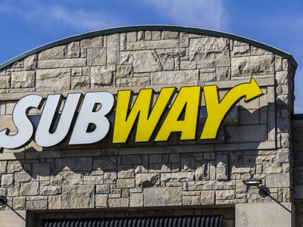
Subway
Fast food restaurant franchise
Bringing back “$5 Footlong” promotion
Franchisees are protesting that their costs are too high to offer a footlong sub sandwich for $5

Slide 3
Cost assumptions per footlong
Cost item | Details | Cost per sandwich
Food ingredients | Per footlong | $ 2.00
Labor cost per footlong | Labor $14.00/hour wage rate, each worker can make 7 sandwiches per hour | 2.00
Credit card transaction fee | 1.0% + $0.10 per transaction | 0.15
Electricity | $360 per month divided by 4,000 orders per month | 0.09
Rent | Rent $1,200 per month divided by 4,000 orders per month | 0.30
Franchise fee amortization | Franchise and startup fees $36,000 divided by 180 months (15 years) divided by 4,000 orders per month | 0.05
Royalty fee | 8.0% of sales | 0.40
Advertising fee | 4.5% of sales | 0.23
Equipment leasing cost | $600 per month divided by 4,000 orders | 0.15
Cost per footlong sandwich |  | $ 5.37

Slide 4
Question 1
Identify each of the listed costs of one footlong sub sandwich as either variable, fixed, or mixed.

Slide 5
Question 2
What costs and factors do you think should be relevant to the footlong sub sandwich pricing decision? Explain.

Slide 6
Question 3
What is the contribution margin of each $5 footlong sub sandwich?

Slide 7
Question 4
Do you agree that a Subway franchisee would lose money for each footlong sold for $5? Why or why not?

Slide 8
Question Recap
Identify each of the listed costs of one footlong sub sandwich as either variable, fixed, or mixed.
What costs and factors do you think should be relevant to the footlong sub sandwich pricing decision? Explain.
What is the contribution margin of each $5 footlong sub sandwich?
Do you agree that a Subway franchisee would lose money for each footlong sold for $5? Why or why not?

Slide 9
For additional news stories to use in the accounting classroom, see the
Accounting in the Headlines blog at http://accountingintheheadlines.com/
Questions or comments?
Dr. Wendy Tietz at wtietz@kent.edu

