Slide 1
When will Maroon 5 recognize revenue from its 2018 concerts at
Madison Square Garden in New York City?
Original blog posting (November 7, 2017)

Slide 2
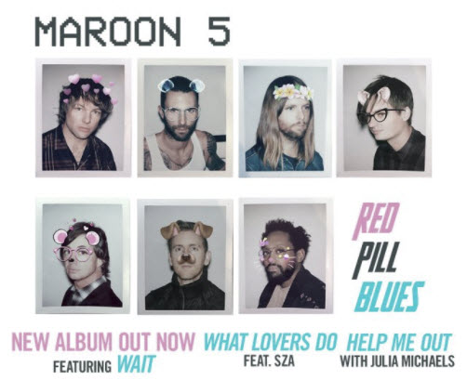

Slide 3
Maroon 5
Red Pill Blues Tour 2018
Two concerts at Madison Square Garden in NYC in October 2018
Seating capacity is 19,000 people
Average ticket price for Maroon 5 is $165
Assume these two concerts sold out on November 4, 2017, the first day the tickets were available
Further assume that all tickets are sold directly by Maroon 5

Slide 4
Question 1
How much gross concert revenue will Maroon receive for the two Madison Square Garden concerts?

Slide 5
Question 2
How will Maroon 5’s balance sheet and income statement be impacted by the sale of the Madison Square Garden tickets on November 4, 2017? What specific accounts will be impacted and in what direction (increased or decreased)?

Slide 6
Question 3
How will Maroon 5’s balance sheet and income statement be impacted by the performance of the October 14, 2018, concert at the Madison Square Garden tickets?

Slide 7
Question Recap
How much gross concert revenue will Maroon receive for the two Madison Square Garden concerts?
How will Maroon 5’s balance sheet and income statement be impacted by the sale of the Madison Square Garden tickets on November 4, 2017? What specific accounts will be impacted and in what direction (increased or decreased)?
How will Maroon 5’s balance sheet and income statement be impacted by the performance of the October 14, 2018, concert at the Madison Square Garden tickets?

Slide 8
For additional news stories to use in the accounting classroom, see the
Accounting in the Headlines blog at http://accountingintheheadlines.com/
Questions or comments?
Dr. Wendy Tietz at wtietz@kent.edu

