Slide 1
Which iPhone model is the most profitable for Apple?
Original blog posting (November 14, 2017)

Slide 2
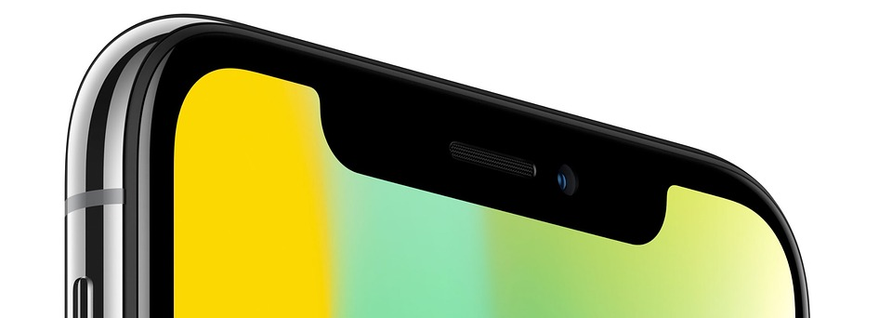
Apple Inc.
In September 2017, Apple announced 3 new iPhone models:
iPhone X, iPhone 8 Plus, iPhone 8
It is continuing to sell older models, such as the iPhone 7

Slide 3
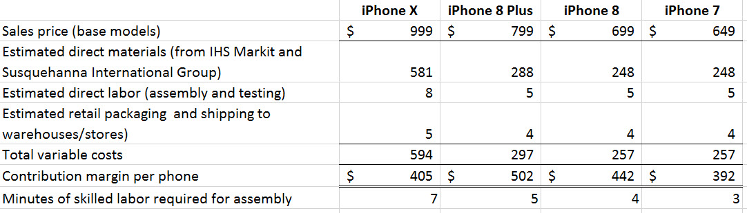
Apple Inc.

Slide 4
Question 1
Which iPhone model is the most profitable for Apple? Which metric are you using to gauge profitability? Defend your choice of metric.

Slide 5
Question 2
Assume that Apple has unlimited demand for every iPhone model. Which model should it emphasize to maximize profits if skilled labor is a scarce resource?

Slide 6
Question 3
Why might Apple offer several iPhone models rather than just the one most profitable model?

Slide 7
Question Recap
Which iPhone model is the most profitable for Apple? Which metric are you using to gauge profitability? Defend your choice of metric.
Assume that Apple has unlimited demand for every iPhone model. Which model should it emphasize to maximize profits if skilled labor is a scarce resource?
Why might Apple offer several iPhone models rather than just the one most profitable model?

Slide 8
For additional news stories to use in the accounting classroom, see the
Accounting in the Headlines blog at http://accountingintheheadlines.com/
Questions or comments?
Dr. Wendy Tietz at wtietz@kent.edu

