Slide 1
What managerial accounting tools could be used to determine whether it would be profitable to redevelop Grossinger’s Catskill Resort Hotel, the inspiration for the movie “Dirty Dancing”?
Original blog posting (November 28, 2017)

Slide 2
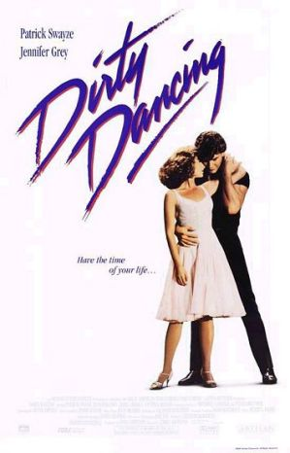
“Dirty Dancing” movie (1987) was based on screenwriter’s family experiences at Grossinger’s Catskill Resort Hotel

Slide 3
Original photos

Slide 4
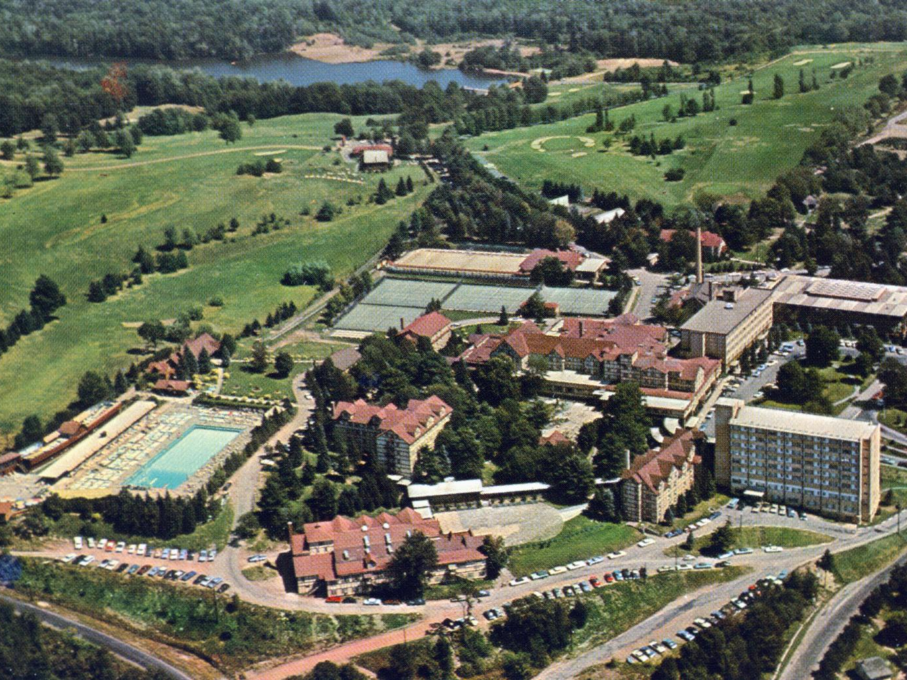
The original Grossinger’s Catskill Resort Hotel, circa 1960s
Photo source: Flickr Commons

Slide 5
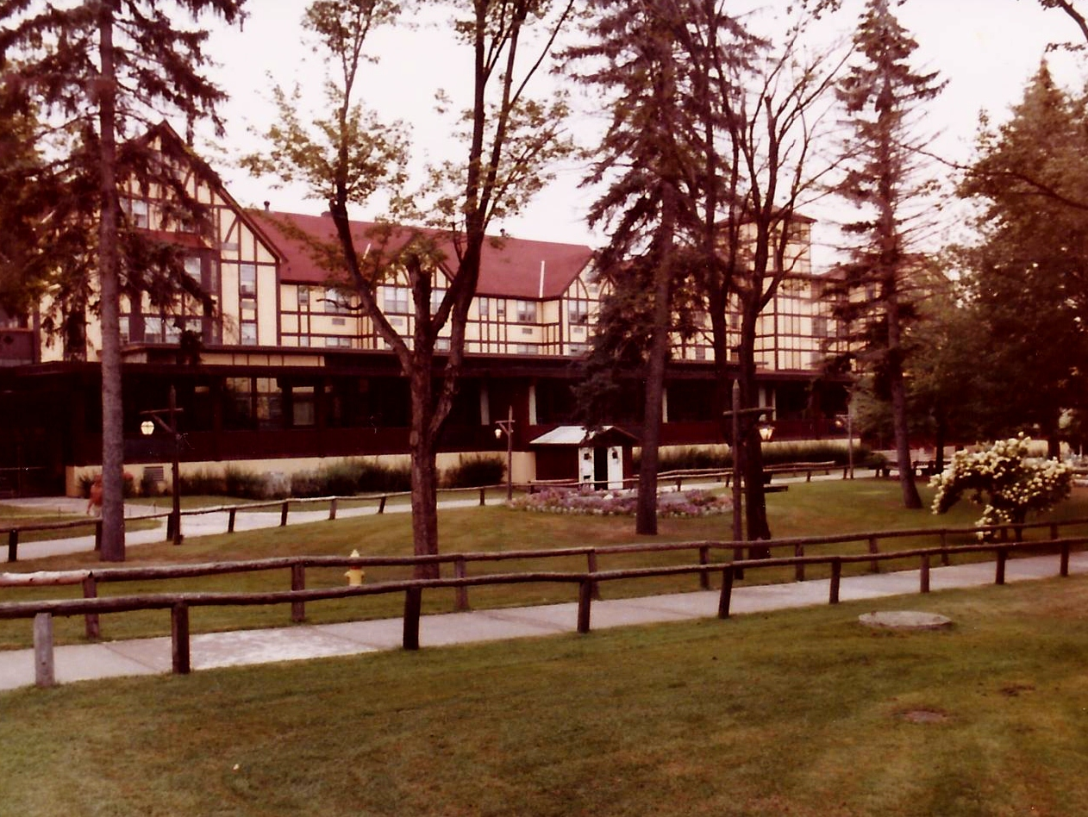
The original Grossinger’s Catskill Resort Hotel, circa 1978
Photo source: Flickr Commons

Slide 6
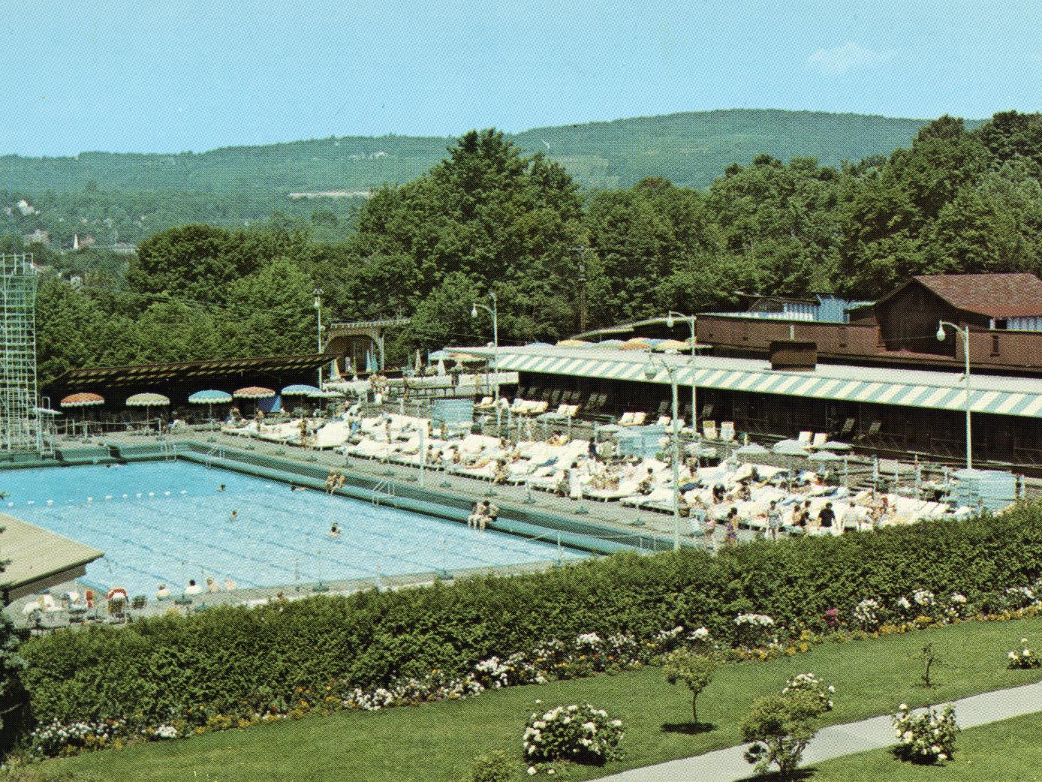
The original Grossinger’s Catskill Resort Hotel, circa 1960s
Photo source: Flickr Commons

Slide 7
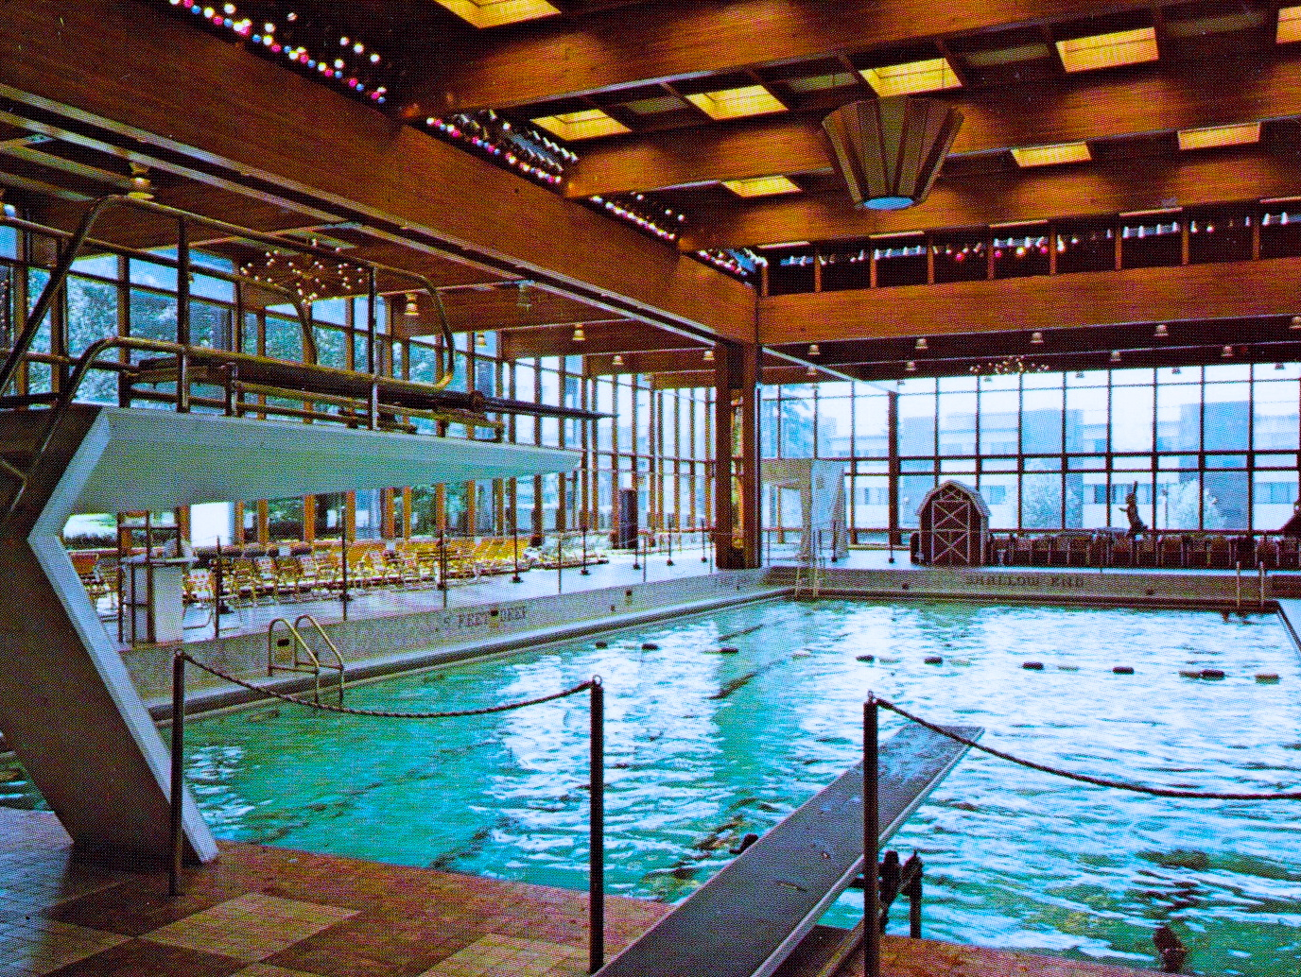
The original Grossinger’s Catskill Resort Hotel, circa 1960s
Photo source: Flickr Commons

Slide 8
Current photos

Slide 9
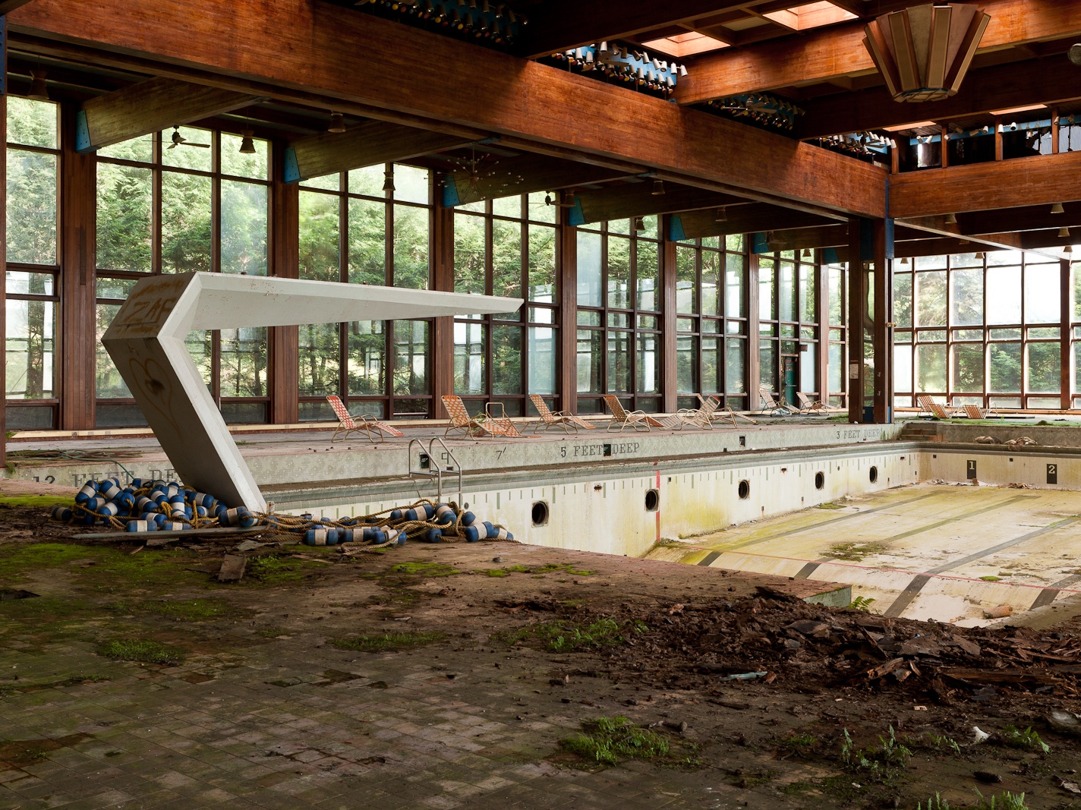
Grossinger’s Catskill Resort Hotel, circa 2014
Photo source: Flickr Commons

Slide 10

Grossinger’s Catskill Resort Hotel, circa 2014
Photo source: Flickr Commons

Slide 11
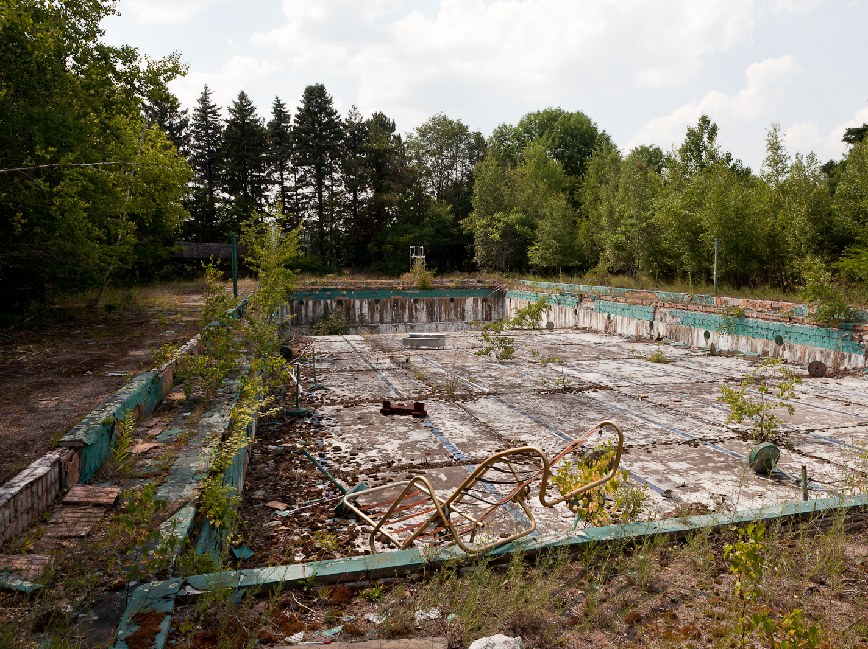
Grossinger’s Catskill Resort Hotel, circa 2014
Photo source: Flickr Commons

Slide 12
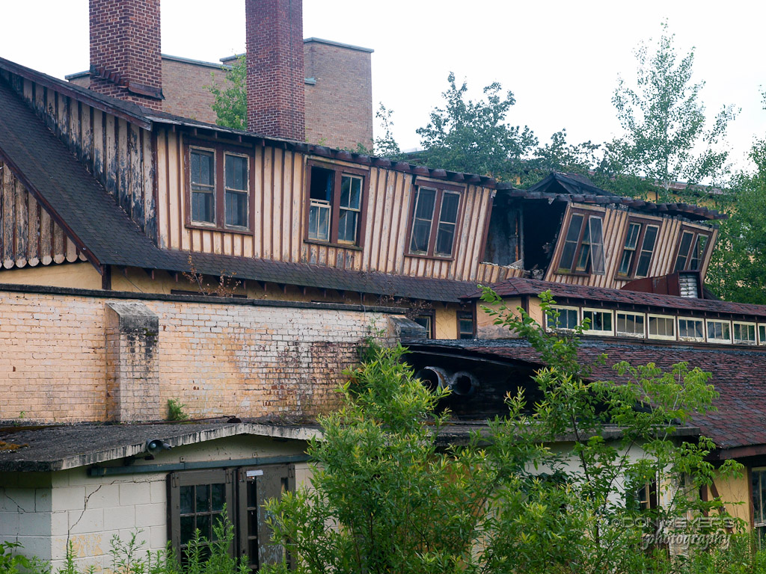
Grossinger’s Catskill Resort Hotel, circa 2014
Photo source: Flickr Commons

Slide 13
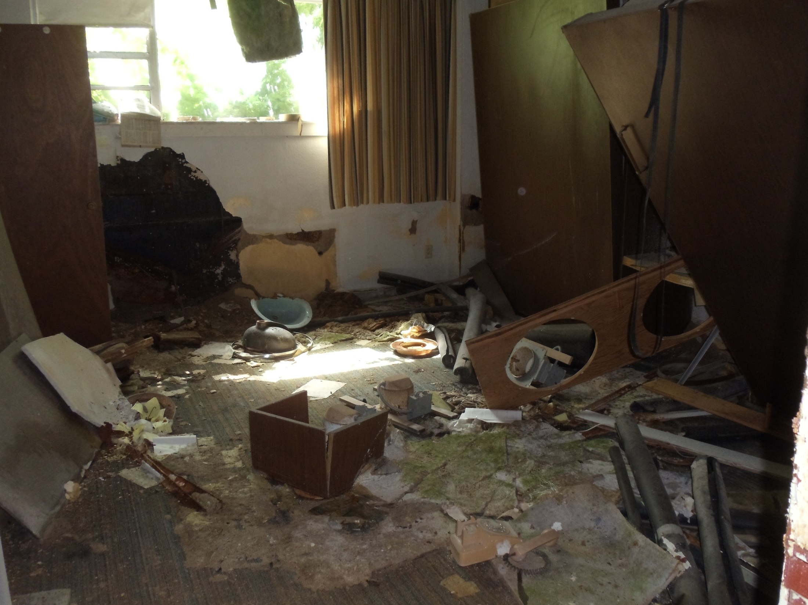
Grossinger’s Catskill Resort Hotel, circa 2014
Photo source: Flickr Commons

Slide 14
Grossinger’s Catskill Resort Hotel, the inspiration for the “Dirty Dancing” movie
Opened in 1919, contained 35 buildings
Had its own airstrip and post office
Louis Cappelli purchased in 2013 to redevelop
Will be removing most of any remaining buildings
Wants to build a conference center, housing, spas, and chalet-style lodging on the site

Slide 15
Question 1
What managerial accounting tools could Cappelli use to help determine whether it would be profitable to redevelop the Grossinger’s property?

Slide 16
Question 2
Would the original price that Cappelli paid in 2013 to purchase the Grossinger’s be relevant to decisions now about how best to redevelop the property? Why or why not?

Slide 17
Question 3
What specific information or estimates would Cappelli need to evaluate whether Grossinger’s should be redeveloped?

Slide 18
Question Recap
What managerial accounting tools could Cappelli use to help determine whether it would be profitable to redevelop the Grossinger’s property?
Would the original price that Cappelli paid in 2013 to purchase the Grossinger’s be relevant to decisions now about how best to redevelop the property? Why or why not?
What specific information or estimates would Cappelli need to evaluate whether Grossinger’s should be redeveloped?

Slide 19
For additional news stories to use in the accounting classroom, see the
Accounting in the Headlines blog at http://accountingintheheadlines.com/
Questions or comments?
Dr. Wendy Tietz at wtietz@kent.edu

