Slide 1
Given that Toys “R” Us has declared bankruptcy, what are its current, quick, and debt ratios?
Original blog posting (October 5, 2017)

Slide 2

Toys “R” Us
Declared Chapter 11 bankruptcy protection in September 2017 for US operations
Wants to restructure or remove some of its debts
Will also be doing similar action in Canada

Slide 3
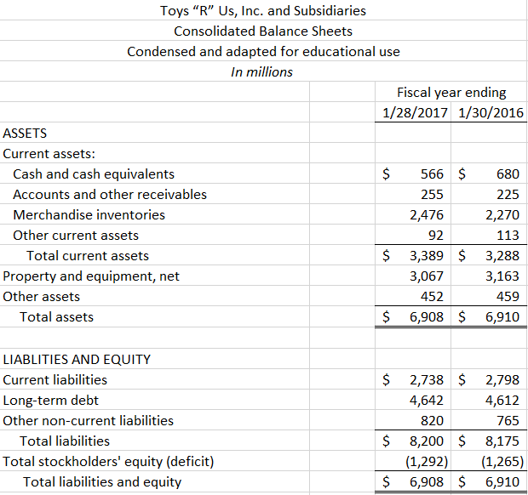
Balance sheets

Slide 4
Question 1
Calculate the Toys “R” Us current ratio for the most recent two years. Interpret these ratios.

Slide 5
Question 2
Calculate the Toys “R” Us quick ratio for the most recent two years. Interpret these ratios. How does the quick ratio compare to the current ratio?

Slide 6
Question 3
Calculate the Toys “R” Us debt ratio for the most recent two years. Interpret these ratios.

Slide 7
Question 4
Why is total stockholders’ equity negative?

Slide 8
Question Recap
Calculate the Toys “R” Us current ratio for the most recent two years. Interpret these ratios.
Calculate the Toys “R” Us quick ratio for the most recent two years. Interpret these ratios. How does the quick ratio compare to the current ratio?
Calculate the Toys “R” Us debt ratio for the most recent two years. Interpret these ratios.
Why is total stockholders’ equity negative?

Slide 9
For additional news stories to use in the accounting classroom, see the Accounting in the Headlines blog at http://accountingintheheadlines.com/
Questions or comments? Contact Dr. Wendy Tietz at wtietz@kent.edu

