Slide 1
Would Subway have disclosed or accrued for the class-action lawsuit filed against it for the length of its footlong subs?
Original blog posting (September 5, 2017)

Slide 2

Class-action lawsuit against Subway
Nine customers filed class-action lawsuit in 2013
“Footlong” subs closer to 11 inches, not 12
Subway reached settlement in 2016
  Plaintiff attorneys would receive $525,000
  Each of nine plaintiffs would receive $500

Slide 3
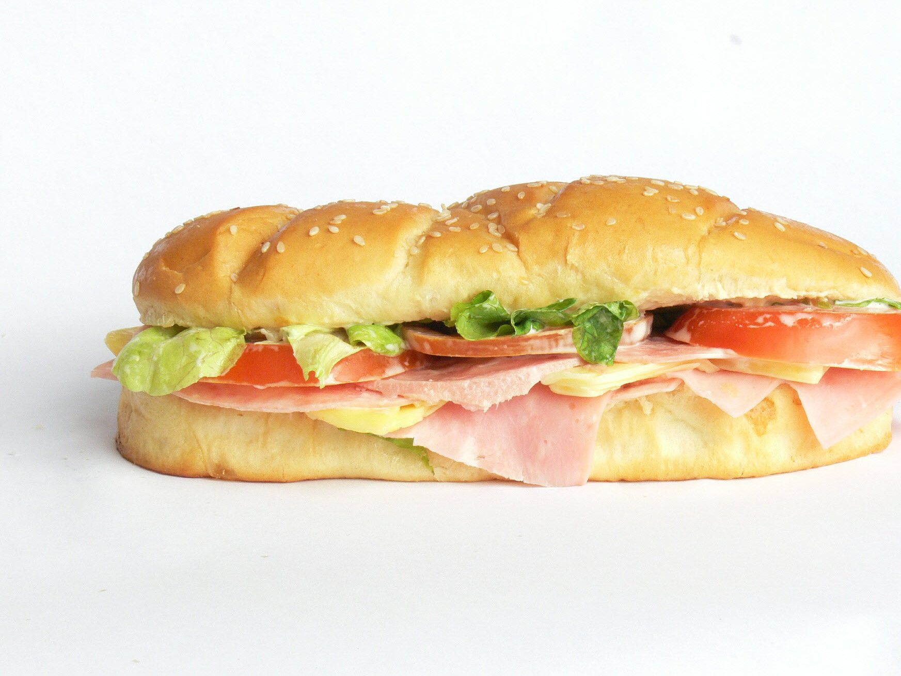
Class-action lawsuit thrown out
Some sandwich rolls will fall short of twelve inches due to the variability inherent in the baking process.
Subway’s customers are allowed to pile on sandwich fillings at no extra charge, giving the customer the same amount of food even if the bun is short of twelve inches.

Slide 4
Question 1
What is a contingent liability?

Slide 5
Question 2
What conditions must be met for a contingent liability to be disclosed (but not accrued) in the financial statements under U.S. GAAP?

Slide 6
Question 3
What conditions must be met for a contingent liability to be disclosed and accrued in the financial statements under U.S. GAAP?

Slide 7
Question 4
In your opinion, would Subway have needed to disclose and/or accrue for the footlong class-action lawsuit? Explain your rationale.

Slide 8
Question Recap
What is a contingent liability?
What conditions must be met for a contingent liability to be disclosed (but not accrued) in the financial statements under U.S. GAAP?
What conditions must be met for a contingent liability to be disclosed and accrued in the financial statements under U.S. GAAP?
In your opinion, would Subway have needed to disclose and/or accrue for the footlong class-action lawsuit? Explain your rationale.

Slide 9
For additional news stories to use in the accounting classroom, see the Accounting in the Headlines blog at http://accountingintheheadlines.com/
Questions or comments? Contact Dr. Wendy Tietz at wtietz@kent.edu

