Slide 1
What information can be calculated from McDonald’s
2016 trial balance?
Original blog posting (September 11, 2017)

Slide 2
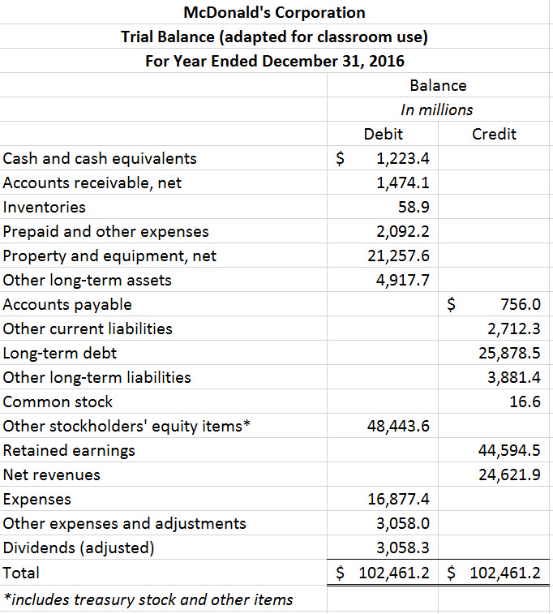
McDonald’s Trial Balance

Slide 3
Discussion Questions (calculate each of the following totals using McDonald’s trial balance)
Current assets
Total assets
Current liabilities
Total liabilities
Net income
Ending retained earnings
Total stockholders’ equity
Write McDonald’s accounting equation as of December 31, 2016.

Slide 4
For additional news stories to use in the accounting classroom, see the Accounting in the Headlines blog at http://accountingintheheadlines.com/
Questions or comments? Contact Dr. Wendy Tietz at wtietz@kent.edu

