Slide 1
What closing entries would McDonald’s have made in 2016 based on its trial balance?
Original blog posting (September 13, 2017)

Slide 2
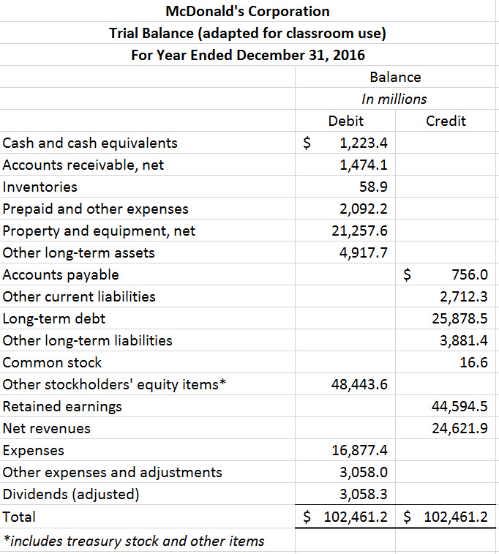
McDonald’s Trial Balance

Slide 3
Question 1
What are closing entries? Why are they made?

Slide 4
Question 2
What accounts on McDonald’s trial balance should be closed?

Slide 5
Question 3
Using the McDonald’s trial balance, what closing entries would McDonald’s make for 2016?

Slide 6
Question 4
What was McDonald’s net income for the year ended December 31, 2016?

Slide 7
Question Recap
What are closing entries? Why are they made?
What accounts on McDonald’s trial balance should be closed?
Using the McDonald’s trial balance, what closing entries would McDonald’s make for 2016?
What was McDonald’s net income for the year ended December 31, 2016?

Slide 8
For additional news stories to use in the accounting classroom, see the Accounting in the Headlines blog at http://accountingintheheadlines.com/
Questions or comments? Contact Dr. Wendy Tietz at wtietz@kent.edu

