Slide 1
How does John Deere account for the loans it makes to farmers for the purchase of tractors and crop supplies?
Original blog posting (September 26, 2017)

Slide 2
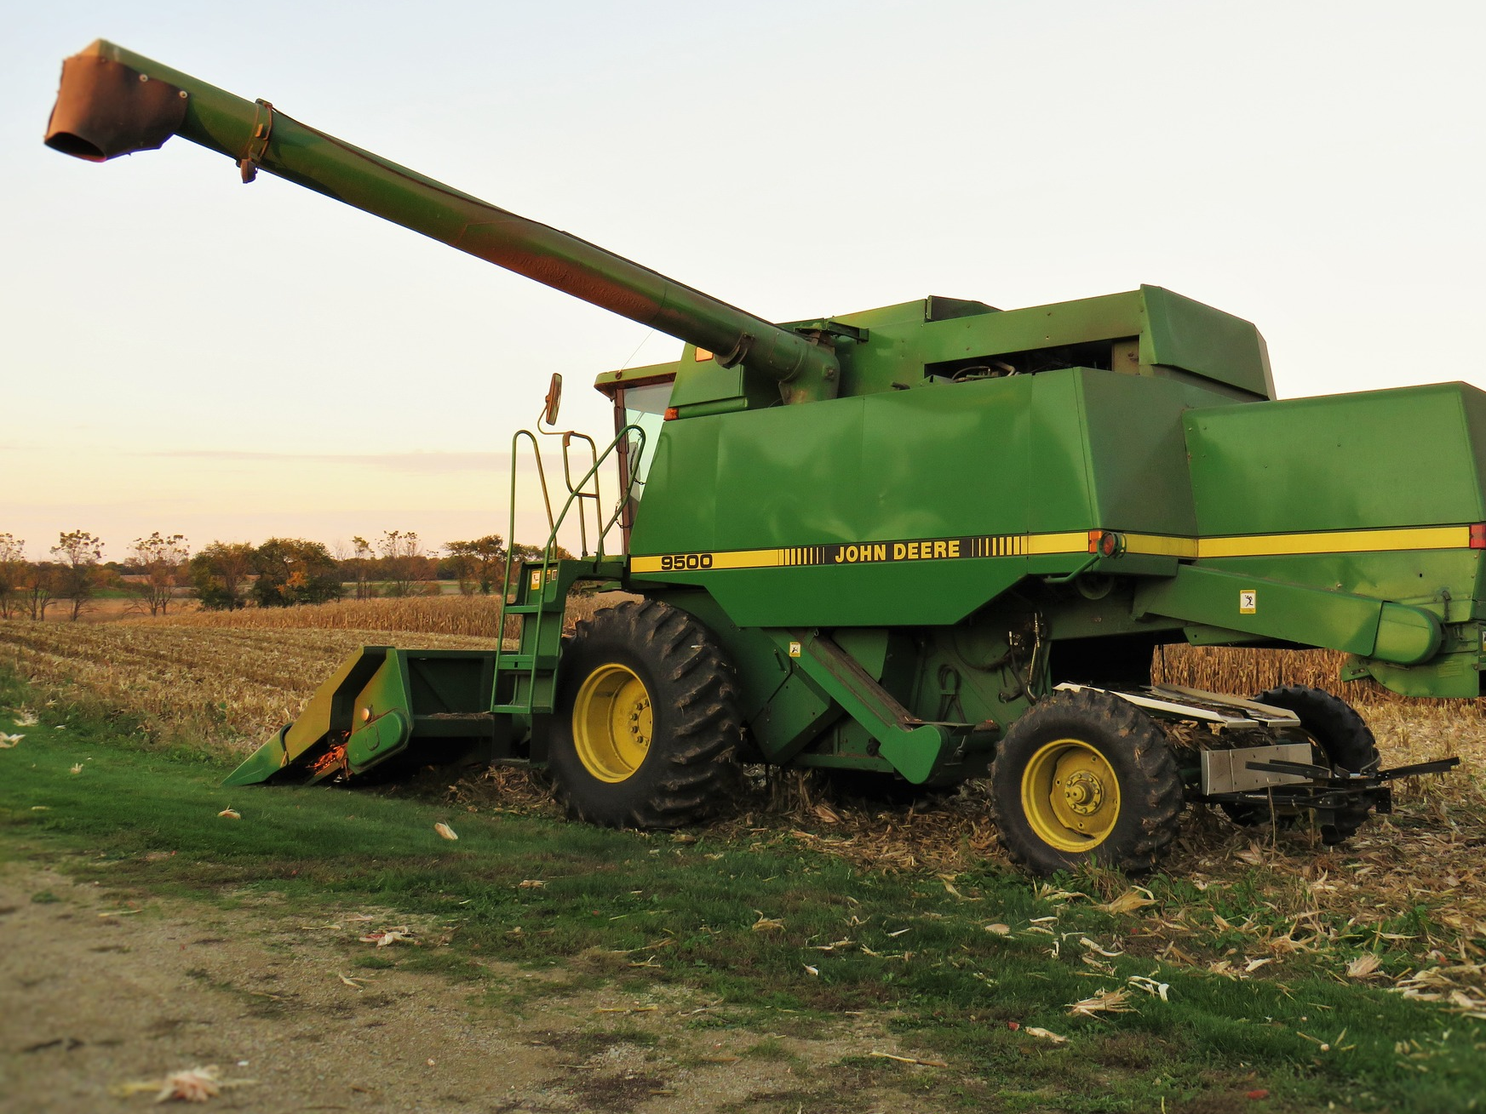
Deere & Company (John Deere)
Makes loans to farmers
  Financing loans for the purchase of Deere equipment
  Cash loans to finance the purchase of crop supplies, such as seeds, fertilizer, and chemicals

Slide 3
Question 1
How would Deere’s assets, liabilities, and equity be impacted when Deere sells farm equipment to a farmer in exchange for a promissory note and a cash down payment? What specific accounts will be affected? Will each of these accounts be increased or decreased?

Slide 4
Question 2
How would Deere’s assets, liabilities, and equity be impacted when Deere makes a cash loan to a farmer? What specific accounts will be affected? Will each of these accounts be increased or decreased?

Slide 5
Question 3
When a farmer makes a loan payment to Deere, what general ledger accounts will be impacted? Will these accounts increase or decrease?

Slide 6
Question Recap
How would Deere’s assets, liabilities, and equity be impacted when Deere sells farm equipment to a farmer in exchange for a promissory note and a cash down payment? What specific accounts will be affected? Will each of these accounts be increased or decreased?
How would Deere’s assets, liabilities, and equity be impacted when Deere makes a cash loan to a farmer? What specific accounts will be affected? Will each of these accounts be increased or decreased?
When a farmer makes a loan payment to Deere, what general ledger accounts will be impacted? Will these accounts increase or decrease?

Slide 7
For additional news stories to use in the accounting classroom, see the Accounting in the Headlines blog at http://accountingintheheadlines.com/
Questions or comments? Contact Dr. Wendy Tietz at wtietz@kent.edu

