Slide 1
How does Apple’s issuance of bonds and buyback of its own stock impact its accounting equation?
Original blog posting (May 16, 2017)

Slide 2
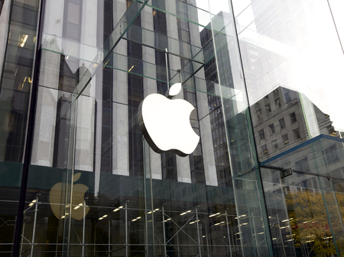
Apple
May 2017: Apple indicated it would be issuing another $7 billion in bonds
Already issued $10 billion in February 2017 in the US and $1 billion in Taiwan
Will buy back some of its own stock with the bond proceeds
Also indicated there will be a 10.5% dividend increase for shareholders
Copyright: <a href='https://www.123rf.com/profile_instinia'>instinia / 123RF Stock Photo</a>

Slide 3
Question 1
What journal entry would Apple make when it issues $7 billion in bonds (ignore underwriting fees)?

Slide 4
Question 2
How are assets, liabilities, and equity impacted by the bond issuance?

Slide 5
Question 3
On what financial statement is the balance of bonds payable shown? Where is it shown on that financial statement?

Slide 6
Question 4
What journal entry would Apple make when it purchases its own stock?

Slide 7
Question 5
How are assets, liabilities, and equity impacted by the stock buyback?

Slide 8
Question 6
On what financial statement is the balance of treasury stock shown? How is treasury stock shown on that financial statement?

Slide 9
Question Recap
What journal entry would Apple make when it issues $7 billion in bonds (ignore underwriting fees)?
How are assets, liabilities, and equity impacted by the bond issuance?
On what financial statement is the balance of bonds payable shown? Where is it shown on that financial statement?
What journal entry would Apple make when it purchases its own stock?
How are assets, liabilities, and equity impacted by the stock buyback?
On what financial statement is the balance of treasury stock shown? How is treasury stock shown on that financial statement?

Slide 10
For additional news stories to use in the accounting classroom, see the Accounting in the Headlines blog at http://accountingintheheadlines.com/
Questions or comments? Contact Dr. Wendy Tietz at wtietz@kent.edu

