Slide 1
How would process costing work for gummy bears to be produced at the new US Haribo manufacturing plant?
Original blog posting (April 11, 2017)

Slide 2
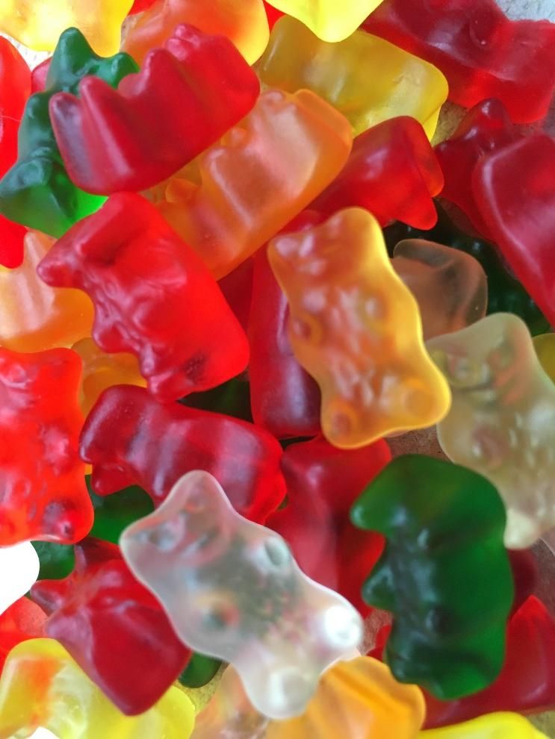
Haribo Gummy Bears
Haribo produces about 100 million gummy bears per day in its 16 plants around the world
Ingredients in gummy bears are sugar, glucose syrup, starch, flavoring, food coloring, citric acid, and gelatin
Produced in five colors
  Red (raspberry)
  Green (strawberry)
  Colorless (pineapple)
  Orange (orange)
  Yellow (lemon)

Slide 3
Haribo Gummy Bears
Produced in special machine called a starch mogul
Steps to production:
  Fill gummy bear mold with powdered starch
  Pour hot, liquid gummy mixture into the tray
  Cool overnight
  Remove the gummy bears
  Package the gummy bears into a variety of package sizes

Slide 4
Question 1
What direct materials are used in the production of gummy bears?

Slide 5
Question 2
What direct labor costs are likely to be incurred in the production of gummy bears?

Slide 6
Question 3
Give several examples of manufacturing overhead costs that are likely to be incurred by Haribo in the production of its gummy bears at the US plant.

Slide 7
Question 4
From the production process description provided, at what point do you think most of the direct materials are added to the process when manufacturing gummy bears?

Slide 8
Question 5
At the end of the month, approximately what percentage complete will those gummy bears be with respect to direct materials?

Slide 9
Question Recap
What direct materials are used in the production of gummy bears?
What direct labor costs are likely to be incurred in the production of gummy bears?
Give several examples of manufacturing overhead costs that are likely to be incurred by Haribo in the production of its gummy bears at the US plant.
From the production process description provided, at what point do you think most of the direct materials are added to the process when manufacturing gummy bears?
At the end of the month, approximately what percentage complete will those gummy bears be with respect to direct materials?

Slide 10
For additional news stories to use in the accounting classroom, see the Accounting in the Headlines blog at http://accountingintheheadlines.com/
Questions or comments? Contact Dr. Wendy Tietz at wtietz@kent.edu

