Slide 1
What internal controls might have stopped a Cargill accountant from embezzling $3.1 million?
Original blog posting (April 25, 2017)

Slide 2
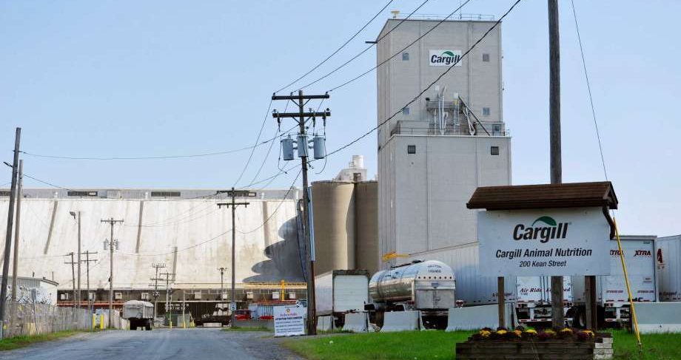
Cargill, Inc.
Largest privately help corporation in the US
In addition to agricultural business, involved in energy, food ingredients, financial services, & broad array of other ventures
Diane Backis – accountant in Albany, NY office for over 10 years
Backis created customer contracts, generated & mailed invoices, & received/processed payments
Estimated Cargill incurred financial losses of more than $25 million due to Backis’ scheme
Source: http://www.timesunion.com

Slide 3
Cargill, Inc.
Backis admitted to stealing $3.1 million from Cargill by doing the following:
  Intercepted payments & deposited them into her personal account
  Created fraudulent invoices each week and mailed to customers
  Charged customers prices below Cargill’s costs, but falsely recorded them at the higher price
  Instructed customers to send payment directly to Albany instead of to Cargill’s lock box
  Misapplied customer payments to the wrong account to cover her fraud
Source: http://www.timesunion.com

Slide 4
Question 1
What procedures allowed the Cargill accountant to embezzle the funds?

Slide 5
Question 2
What changes to accounting procedures do you think Cargill could make to prevent future embezzlement of this nature?

Slide 6
Question Recap
What procedures allowed the Cargill accountant to embezzle the funds?
What changes to accounting procedures do you think Cargill could make to prevent future embezzlement of this nature?

Slide 7
For additional news stories to use in the accounting classroom, see the Accounting in the Headlines blog at http://accountingintheheadlines.com/
Questions or comments? Contact Dr. Wendy Tietz at wtietz@kent.edu

