Slide 1
How will Dr Pepper Snapple’s dividend impact its financial statements?
Original blog posting (March 21, 2017)

Slide 2
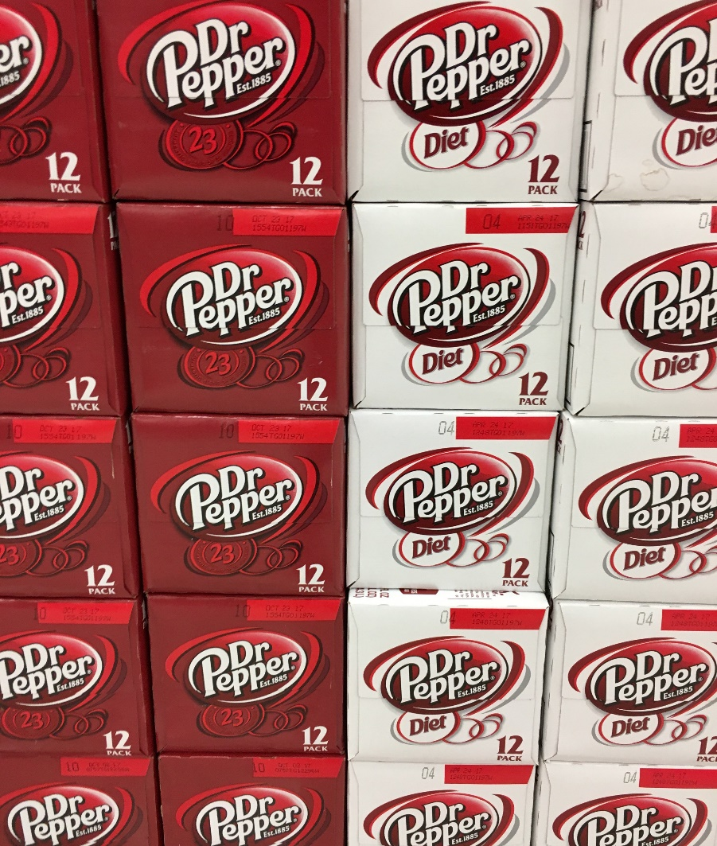
Dr Pepper Snapple Group, Inc.
November 6, 2016, Dr Pepper Snapple Group, Inc. announced:
  Dividend of $0.53 per share of common stock
  Payable in U.S. dollars on January 5, 2017
  To shareholders of record on December 13, 2016

Slide 3
Question 1
What is the declaration date? How will assets, liabilities, and equity be impacted, if at all, on this date?

Slide 4
Question 2
What is the date of record? How will assets, liabilities, and equity be impacted, if at all, on this date?

Slide 5
Question 3
What is the date of payment? How will assets, liabilities, and equity be impacted, if at all, on this date?

Slide 6
Question 4
How will the income statement be impacted, if at all, by the dividend declaration? Explain.

Slide 7
Question 5
How will the statement of retained earnings be impacted by the dividend declaration? Explain.

Slide 8
Question 6
How and when will the statement of cash flows be impacted by this dividend? Explain.

Slide 9
Question Recap
What is the declaration date? How will assets, liabilities, and equity be impacted, if at all, on this date?
What is the date of record? How will assets, liabilities, and equity be impacted, if at all, on this date?
What is the date of payment? How will assets, liabilities, and equity be impacted, if at all, on this date?
How will the income statement be impacted, if at all, by the dividend declaration? Explain.
How will the statement of retained earnings be impacted by the dividend declaration? Explain.
How and when will the statement of cash flows be impacted by this dividend? Explain.

Slide 10
For additional news stories to use in the accounting classroom, see the Accounting in the Headlines blog at http://accountingintheheadlines.com/
Questions or comments? Contact Dr. Wendy Tietz at wtietz@kent.edu

