Slide 1
How might Target use data analytics to help make decisions?
Original blog posting (February 28, 2017)

Slide 2
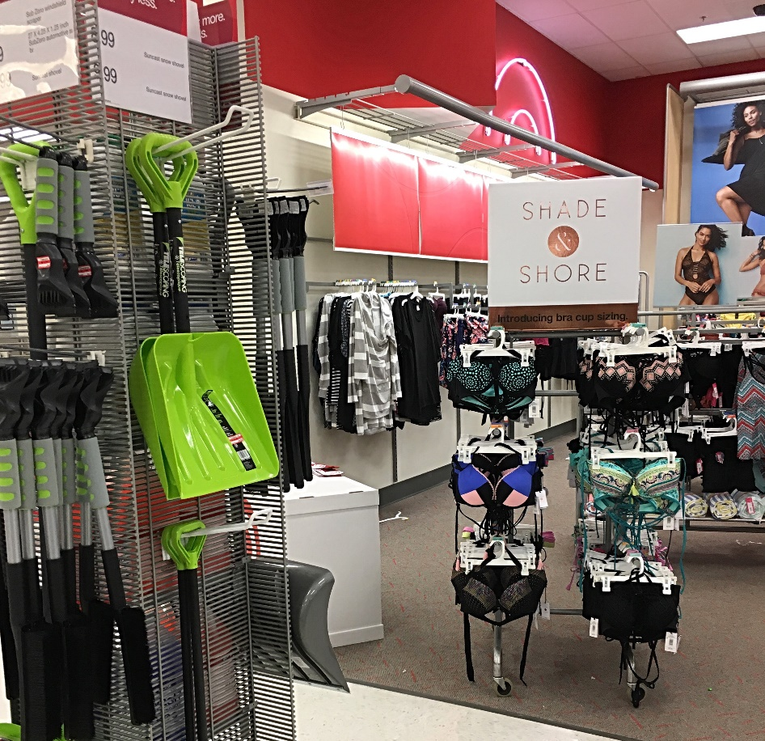
Target
During a February visit to Target in NE Ohio, snow shovels can be seen on display next to swimming suits
Fashion Institute of Technology in NYC recently began offering a course: “Predictive Analytics for Planning and Forecasting: Case Studies on Weatherization”
Course involves how companies can use big data about weather to help make stocking decisions

Slide 3
Question 1
Think about Target or another discount store retailer. How might it make use of big data related to weather? Explain.

Slide 4
Question 2
What other types of big data might be useful to Target or other discount store retailers? Explain.

Slide 5
Question Recap
Think about Target or another discount store retailer. How might it make use of big data related to weather? Explain.
What other types of big data might be useful to Target or other discount store retailers? Explain.

Slide 6
For additional news stories to use in the accounting classroom, see the Accounting in the Headlines blog at http://accountingintheheadlines.com/
Questions or comments? Contact Dr. Wendy Tietz at wtietz@kent.edu

