Slide 1
How many Classic Moana™ dolls must Disney sell to cover its costs of developing the sustainable packaging for the doll?
Original blog posting (December 1, 2016)

Slide 2
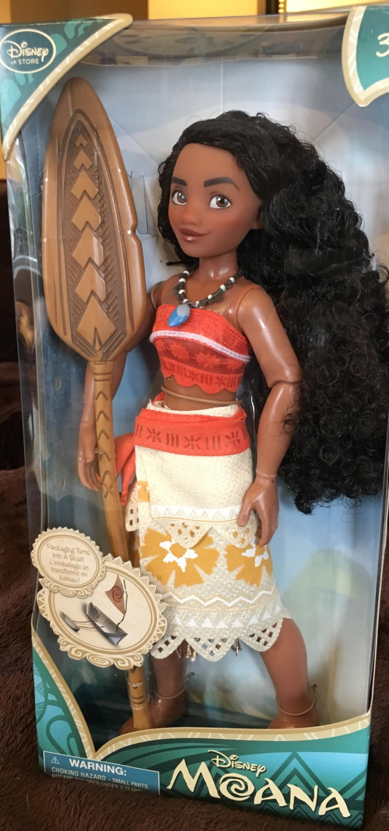
Moana™ doll
Walt Disney’s new movie, Moana ™, opened in November 2016
Released a doll modeled after the heroine of the movie
Smart Packaging Initiative
  Design for recyclability
  Responsible sourcing
  Material optimization
Doll packaging 70% recyclable
Development costs likely include: engineering, special materials, and marketing

Slide 3
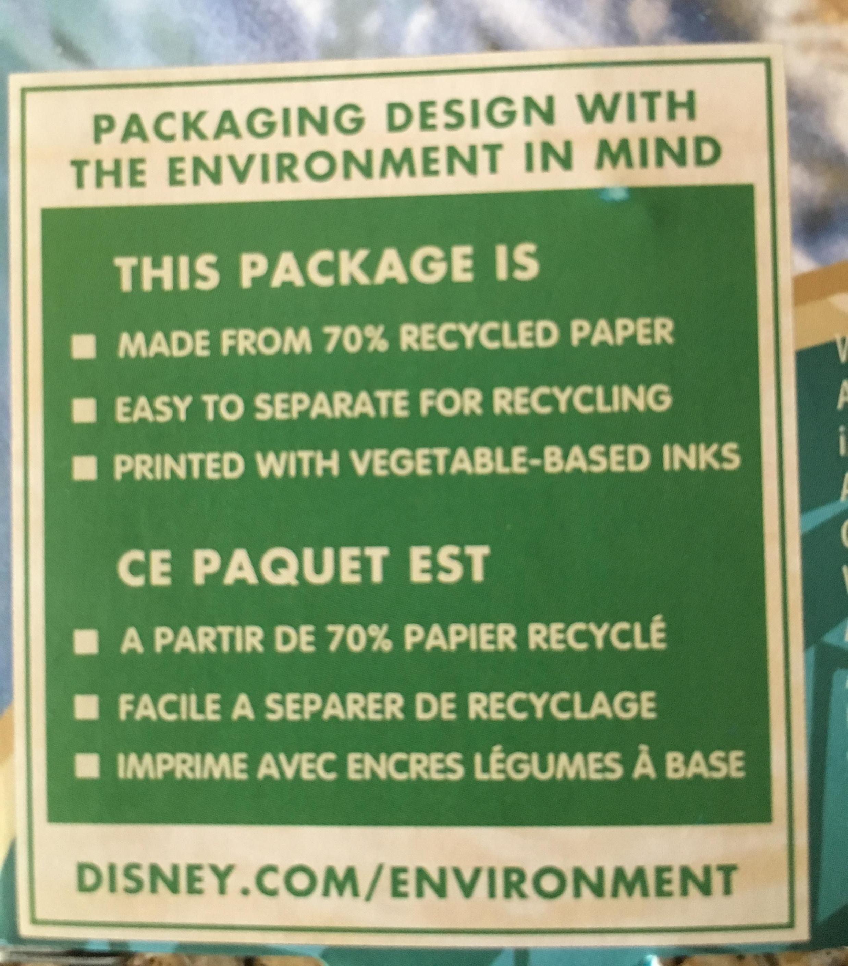
Packaging

Slide 4
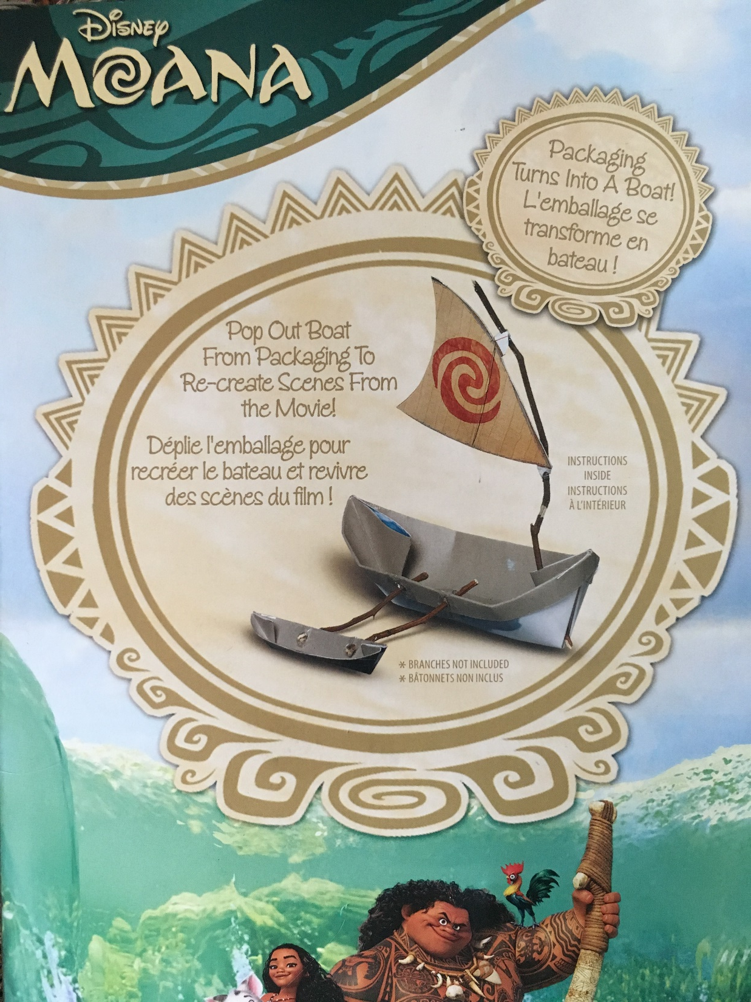
Packaging can be made into a boat

Slide 5
Question 1
Would Disney include the costs of developing its SPI tool in calculating the break even volume for its Moana™ doll packaging? Why or why not?

Slide 6
Question 2
Assume that Disney invested $2 million in developing the sustainable packaging for the Moana™ doll and that it has a contribution margin ratio of 40% on its toy line in general. What would be the break even volume of Moana™ dolls for the sustainable packaging development costs? Assume these sustainable design costs are the only fixed costs incurred in the manufacture of the Moana™ dolls.

Slide 7
Question 3
Do you think Disney is motivated by profits only when developing its sustainable packaging? Why or why not?

Slide 8
Question Recap
Would Disney include the costs of developing its SPI tool in calculating the break even volume for its Moana™ doll packaging? Why or why not?
Assume that Disney invested $2 million in developing the sustainable packaging for the Moana™ doll and that it has a contribution margin ratio of 40% on its toy line in general. What would be the break even volume of Moana™ dolls for the sustainable packaging development costs? Assume these sustainable design costs are the only fixed costs incurred in the manufacture of the Moana™ dolls.
Do you think Disney is motivated by profits only when developing its sustainable packaging? Why or why not?

Slide 9
For additional news stories to use in the accounting classroom, see the Accounting in the Headlines blog at http://accountingintheheadlines.com/
Questions or comments? Contact Dr. Wendy Tietz at wtietz@kent.edu

