Slide 1
What is the impact on Abercrombie & Fitch’s financial statements from the write-down of its logo-adorned merchandise inventory?
Original blog posting (November 8, 2016)

Slide 2
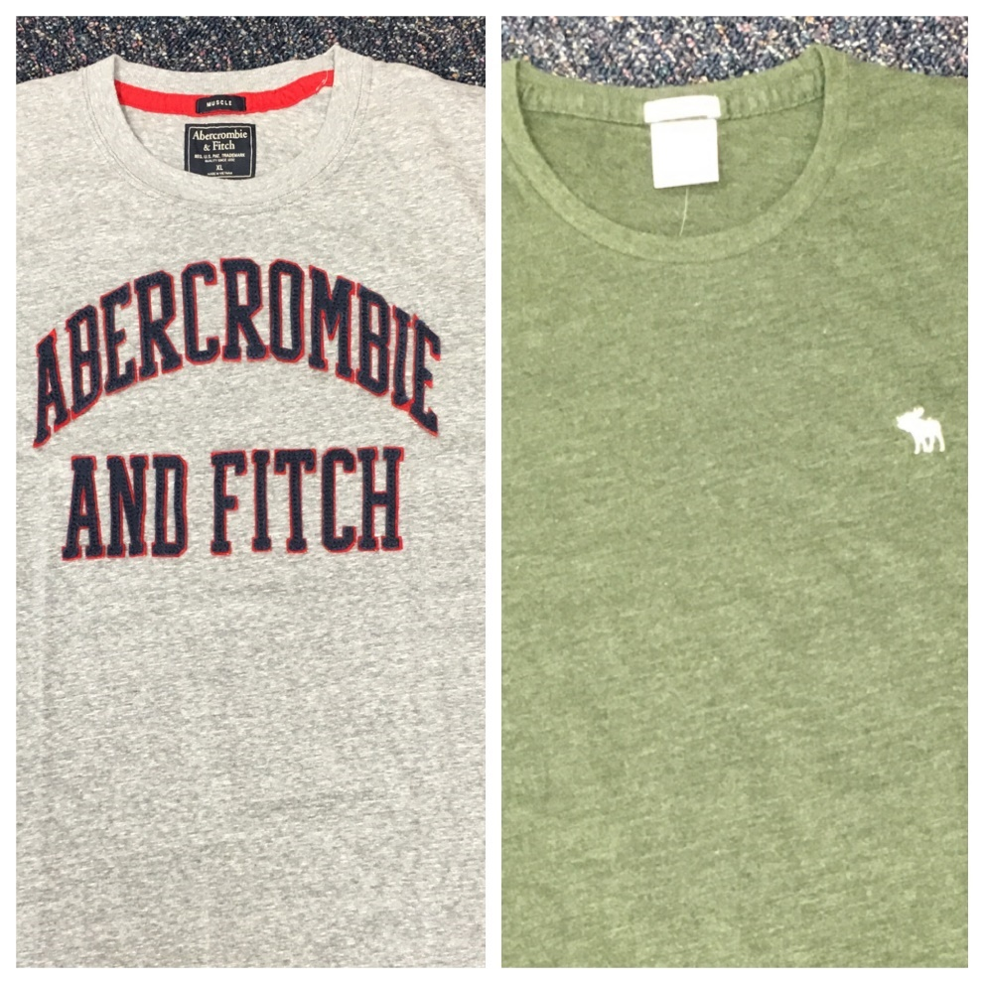
Abercrombie & Fitch
Turnaround strategy due to falling sales
New, subtler logo
Using LCM, wrote down $20.6 million of inventory, including logo-adorned merchandise
Reported income of $35.6 million after the write-down
Excluded write-down from non-GAAP income measures presented to investors

Slide 3
Question 1
What does “write-down” mean?

Slide 4
Question 2
What journal entry would Abercrombie & Fitch have made to write down its merchandise inventory during the year ended January 30, 2016?

Slide 5
Question 3
What impact would the write-down of inventory have had on Abercrombie’s assets? Liabilities? Equity?

Slide 6
Question 4
What impact would the write-down of inventory have had on Abercrombie’s expenses? Gross margin? Net income?

Slide 7
Question 5
What impact, if any, would the write-down of inventory have had on Abercrombie’s current ratio?

Slide 8
Question 6
From an investor standpoint, do you think that the effect of the inventory write-down should be considered when evaluating Abercrombie & Fitch? Explain.

Slide 9
Question Recap
What does “write-down” mean?
What journal entry would Abercrombie & Fitch have made to write down its merchandise inventory during the year ended January 30, 2016?
What impact would the write-down of inventory have had on Abercrombie’s assets? Liabilities? Equity?
What impact would the write-down of inventory have had on Abercrombie’s expenses? Gross margin? Net income?
What impact, if any, would the write-down of inventory have had on Abercrombie’s current ratio?
From an investor standpoint, do you think that the effect of the inventory write-down should be considered when evaluating Abercrombie & Fitch? Explain.

Slide 10
For additional news stories to use in the accounting classroom, see the Accounting in the Headlines blog at http://accountingintheheadlines.com/
Questions or comments? Contact Dr. Wendy Tietz at wtietz@kent.edu

