Slide 1
How would Microsoft’s $40 billion stock buyback and cash dividend impact its balance sheet?
Original blog posting (November 15, 2016)

Slide 2
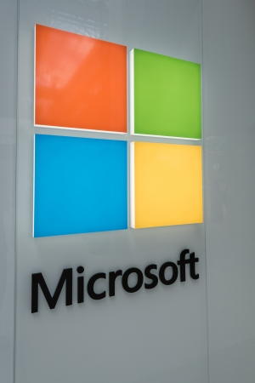
Microsoft Corporation
Planning to buy back up to $40 billion of its own stock
September 20, 2016, stated it would be increasing cash dividend by 8% and declared the dividend
Shareholders as of November 17, 2016, will receive the dividend
Dividend to be paid on December 8, 2016

Slide 3
Question 1
What is a stock buyback? Why might Microsoft want have a stock buyback?

Slide 4
Question 2
What is the impact on assets, liabilities, and stockholders’ equity of a stock buyback?

Slide 5
Question 3
On what date would the dividend in the story become a liability for Microsoft?

Slide 6
Question 4
If an investor would purchase Microsoft stock on December 1, 2016, would that investor be entitled to the dividend that is to be paid on December 8, 2016? Explain.

Slide 7
Question Recap
What is a stock buyback? Why might Microsoft want have a stock buyback?
What is the impact on assets, liabilities, and stockholders’ equity of a stock buyback?
On what date would the dividend in the story become a liability for Microsoft?
If an investor would purchase Microsoft stock on December 1, 2016, would that investor be entitled to the dividend that is to be paid on December 8, 2016? Explain.

Slide 8
For additional news stories to use in the accounting classroom, see the Accounting in the Headlines blog at http://accountingintheheadlines.com/
Questions or comments? Contact Dr. Wendy Tietz at wtietz@kent.edu

