Slide 1
How did a cash dividend impact Lowe’s financial position?
Original blog posting (November 3, 2016)

Slide 2
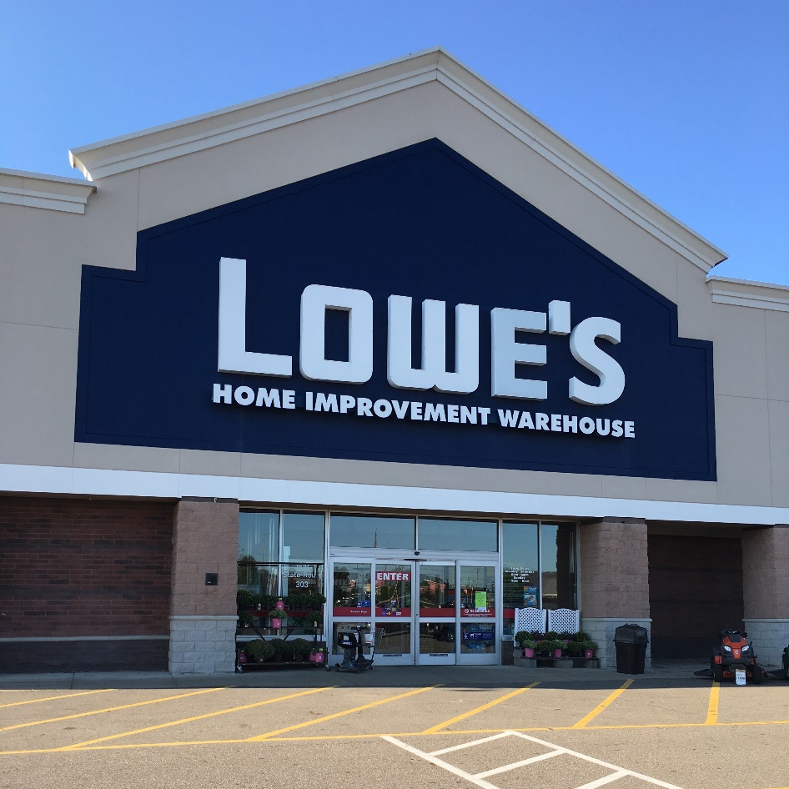
Lowe’s Companies, Inc.
November 2, 2016: Lowe’s paid cash dividend of $0.35 per share
To shareholders of record as of October 19, 2016
Board of Directors declared this on August 19, 2016
As of January 29, 2016: 910 million shares of common stock issued and outstanding

Slide 3
Question 1
Name each of the dates related to Lowe’s cash dividend: (a) August 19, 2016; (b) October 19, 2016; and (c) November 2, 2016.

Slide 4
Question 2
On August 19, 2016, how will Lowe’s assets, liabilities, and stockholders’ equity be impacted by the Board of Directors’ action?

Slide 5
Question 3
On October 19, 2016, how will Lowe’s assets, liabilities, and stockholders’ equity be impacted by the Board of Directors’ action?

Slide 6
Question 4
On November 2, 2016, how will Lowe’s assets, liabilities, and stockholders’ equity be impacted by the Board of Directors’ action?

Slide 7
Question 5
What is the total amount of the cash dividend that Lowe’s will pay related to this announcement?

Slide 8
Question Recap
1. Name each of the dates related to Lowe’s cash dividend: (a) August 19, 2016; (b) October 19, 2016; and (c) November 2, 2016.
2. On August 19, 2016, how will Lowe’s assets, liabilities, and stockholders’ equity be impacted by the Board of Directors’ action?
3. On October 19, 2016, how will Lowe’s assets, liabilities, and stockholders’ equity be impacted by the Board of Directors’ action?
4. On November 2, 2016, how will Lowe’s assets, liabilities, and stockholders’ equity be impacted by the Board of Directors’ action?
5. What is the total amount of the cash dividend that Lowe’s will pay related to this announcement?

Slide 9
For additional news stories to use in the accounting classroom, see the Accounting in the Headlines blog at http://accountingintheheadlines.com/
Questions or comments? Contact Dr. Wendy Tietz at wtietz@kent.edu

