Slide 1
How would the strike at Just Born, the maker of Peeps, impact its standard costing variances?
Original blog posting (November 10, 2016)

Slide 2
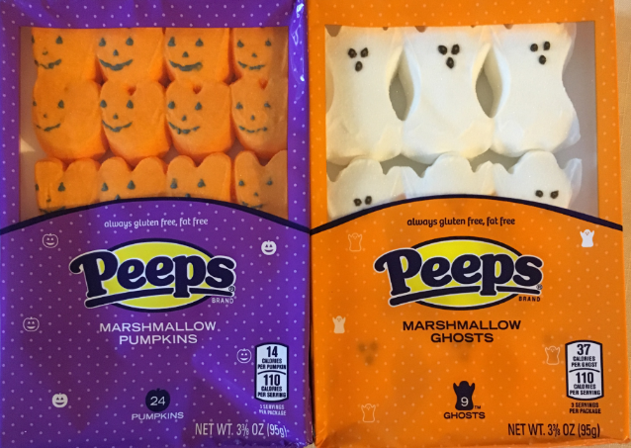
Just Born Quality Confections
Produces Peeps, Mike and Ikes, and other candies
Sept. 2016 some factory employees went on strike for about one month
Just Born hired 56 replacement workers
Ongoing negotiations between the company and the union around retirement plans and pay increases

Slide 3
Question 1
Do you think that factory wages in total during the strike would be higher, lower, or the same throughout the strike and negotiations as compared to earlier in the year? Explain.

Slide 4
Question 2
Do you think that factory wages per hour during the strike would be higher, lower, or the same throughout the strike and negotiations as compared to earlier in the year? Explain.

Slide 5
Question 3
What standard costing variances could be impacted by the strike and negotiations? Explain.

Slide 6
Question Recap
Do you think that factory wages in total during the strike would be higher, lower, or the same throughout the strike and negotiations as compared to earlier in the year? Explain.
Do you think that factory wages per hour during the strike would be higher, lower, or the same throughout the strike and negotiations as compared to earlier in the year? Explain.
What standard costing variances could be impacted by the strike and negotiations? Explain.

Slide 7
For additional news stories to use in the accounting classroom, see the Accounting in the Headlines blog at http://accountingintheheadlines.com/
Questions or comments? Contact Dr. Wendy Tietz at wtietz@kent.edu

