Slide 1
What information and tools would Delta Air have used when it decided to invest in an RFID-based luggage tracking system for preventing lost bags?
Original blog posting (November 27, 2016)

Slide 2
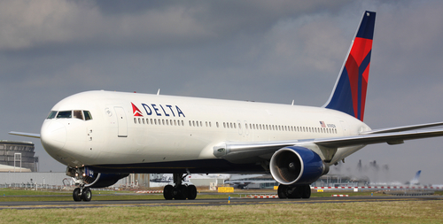
Delta Air Lines
Costs an average of $70 to get lost luggage back to its owner
Delta invested $50 million in RFID luggage tracking
RFID system is over 99.9% accurate
Can prioritize customers with tight connections
Customers can install an app to track luggage
International Air Transport Association mandated airlines improve luggage tracking by 2018

Slide 3
Question 1
What information would you need to calculate the NPV of the RFID luggage tag system?

Slide 4
Question 2
Calculate the payback period for the RFID-based luggage tracking system, assuming that Delta handles 400,000 checked bags per year.

Slide 5
Question 3
What qualitative factors might have been factored into Delta’s decision to adopt the RFID-based system?

Slide 6
Question 4
Which tool, NPV or payback, would most likely have been used to assess whether Delta would implement the RFID system? Explain.

Slide 7
Question Recap
What information would you need to calculate the NPV of the RFID luggage tag system?
Calculate the payback period for the RFID-based luggage tracking system, assuming that Delta handles 400,000 checked bags per year.
What qualitative factors might have been factored into Delta’s decision to adopt the RFID-based system?
Which tool, NPV or payback, would most likely have been used to assess whether Delta would implement the RFID system? Explain.

Slide 8
For additional news stories to use in the accounting classroom, see the Accounting in the Headlines blog at http://accountingintheheadlines.com/
Questions or comments? Contact Dr. Wendy Tietz at wtietz@kent.edu

