Slide 1
How will the opening of a new Cheesecake Factory in New York City impact Cheesecake Factory’s financial statements?
Original blog posting (November 17, 2016)

Slide 2
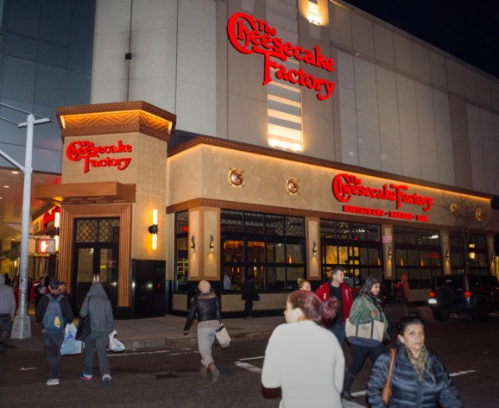
The Cheesecake Factory
Opened first NYC location in late October 2016
8,850 square feet and seats 240 guests
Typically, long-term lease for each location and depreciates over life of the lease
Average cost to build and equip new restaurant is $800 per square foot
Estimated total cost of new location is $7 million

Slide 3
Question 1
Assume that the Cheesecake Factory paid cash for all costs of building and equipping its new restaurant in NYC. How would its assets, liabilities, and equity each be impacted by the construction and opening of this restaurant in 2016? (Ignore the impact of depreciation when answering this question.)

Slide 4
Question 2
On which 2016 financial statement would you find the costs of building and equipping this new restaurant?

Slide 5
Question 3
Which financial statement(s) would be impacted by depreciation on this new restaurant and its furniture and fixtures? How would Cheesecake Factory’s assets, liabilities, and equity be impacted by the depreciation? How would its income be impacted?

Slide 6
Question Recap
Assume that the Cheesecake Factory paid cash for all costs of building and equipping its new restaurant in NYC. How would its assets, liabilities, and equity each be impacted by the construction and opening of this restaurant in 2016? (Ignore the impact of depreciation when answering this question.)
On which 2016 financial statement would you find the costs of building and equipping this new restaurant?
Which financial statement(s) would be impacted by depreciation on this new restaurant and its furniture and fixtures? How would Cheesecake Factory’s assets, liabilities, and equity be impacted by the depreciation? How would its income be impacted?

Slide 7
For additional news stories to use in the accounting classroom, see the Accounting in the Headlines blog at http://accountingintheheadlines.com/
Questions or comments? Contact Dr. Wendy Tietz at wtietz@kent.edu

