Slide 1
What managerial accounting tools could be used by Giant Eagle to evaluate whether it should put refrigerator doors in its dairy section?
Original blog posting (October 18, 2016)

Slide 2
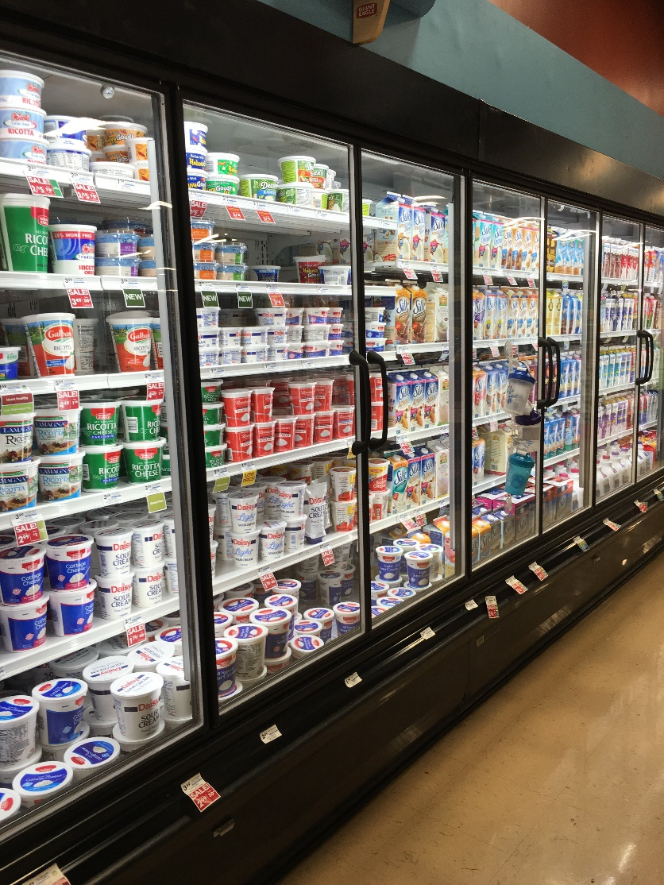
Giant Eagle
Grocery store chain
Locations in IN, MD, OH, PA, and WV
Recently installed refrigerated doors on the dairy section in many stores
Reportedly will use 78% less energy in dairy section now

Slide 3
Question 1
What factors could be relevant in Giant Eagle’s decision about whether to install the dairy doors or not? List as many factors as you can think of; use your imagination.

Slide 4
Question 2
Of the factors you listed in Question 1, which are qualitative in nature? Which are quantitative considerations?

Slide 5
Question 3
What managerial accounting tools might be used by Giant Eagle in evaluating whether to purchase and install the dairy doors? Again, list as many tools as might be useful.

Slide 6
Question 4
Of the tools you listed in Question 3, what tool would you consider would be most useful? Why?

Slide 7
Question Recap
1. What factors could be relevant in Giant Eagle’s decision about whether to install the dairy doors or not? List as many factors as you can think of; use your imagination.
2. Of the factors you listed in Question 1, which are qualitative in nature? Which are quantitative considerations?
3. What managerial accounting tools might be used by Giant Eagle in evaluating whether to purchase and install the dairy doors? Again, list as many tools as might be useful.
4. Of the tools you listed in Question 3, what tool would you consider would be most useful? Why?

Slide 8
For additional news stories to use in the accounting classroom, see the Accounting in the Headlines blog at http://accountingintheheadlines.com/
Questions or comments? Contact Dr. Wendy Tietz at wtietz@kent.edu

