Slide 1
How could the different inventory costing methods used by Best Buy, Amazon, and Target impact their respective income statements and balance sheets?
Original blog posting (October 11, 2016)

Slide 2
Hypothetical Example: Best Buy, Amazon, and Target
Three retail giants, Best Buy, Amazon, and Target each use a different inventory costing method:
Best Buy – weighted-average cost
Amazon – FIFO
Target -LIFO

Slide 3
Basic facts for example
Selling price per unit | $ 32.00
 | Units | Per unit cost | Total cost
Beginning inventory (BI) | 3 | $ 10.00 | $ 30.00
Purchased | 2 | $ 15.00 | $ 30.00
Total available | 5 |  | $ 60.00
Sold | 4
Ending inventory (EI) | 1

Slide 4
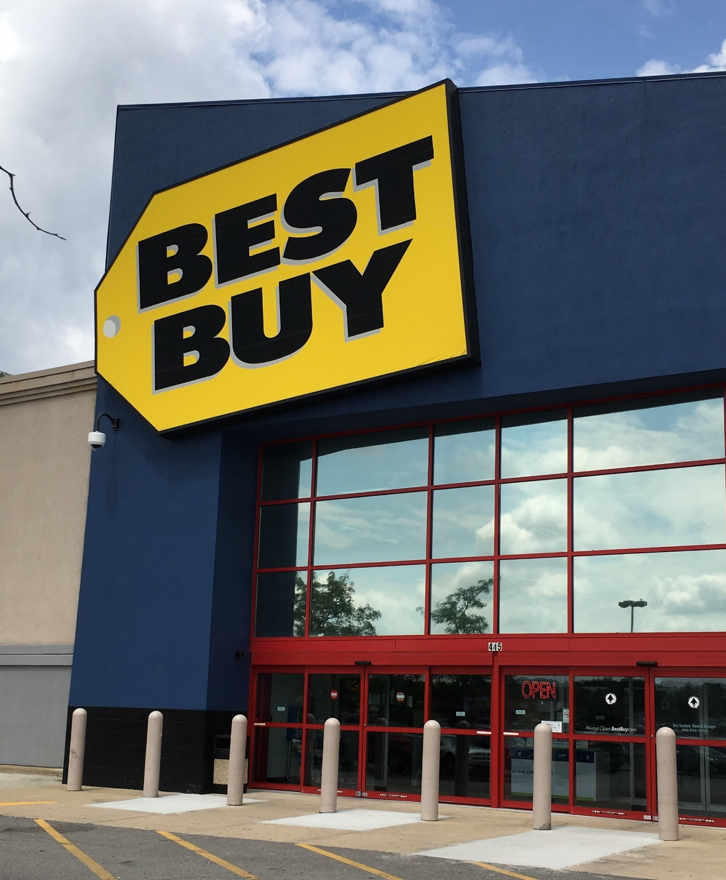
Hypothetical Example:
Best Buy, Amazon, and Target
Best Buy:
Weighted-average

Slide 5
Weighted-average: Best Buy
Weighted-average: Best Buy
Total cost | $ 60.00
Divided by total available | 5
Weighted-average cost per unit | $ 12.00
Value of ending inventory (EI):
# of units left x weighted-average cost | $ 12.00
Cost of goods sold (COGS):
# of units sold x weighted-average cost | $ 48.00
Gross margin (income):
Sales revenue (# of units sold x selling price) | $ 128.00
Less cost of goods sold | 48.00
Gross margin using weighted-average cost | $ 80.00

Slide 6
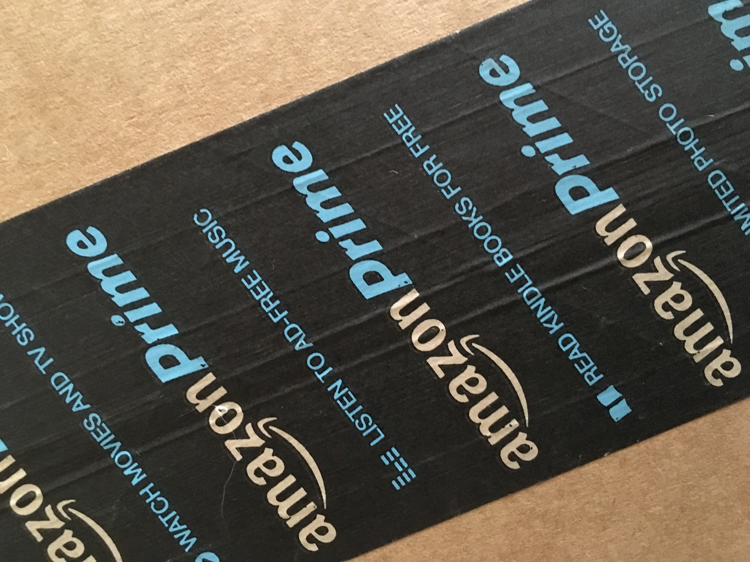
Hypothetical Example:
Best Buy, Amazon, and Target
Amazon: FIFO

Slide 7
FIFO: Amazon
Oldest units sold first, so units in EI were from purchases
Value of ending inventory:
Cost per unit of purchases x units in EI | $ 15.00
COGS:
Total cost of units available less EI | $ 45.00
Gross margin (income):
Sales revenue (# of units sold x selling price) | $ 128.00
Less cost of goods sold | 45.00
Gross margin using FIFO | $ 83.00

Slide 8
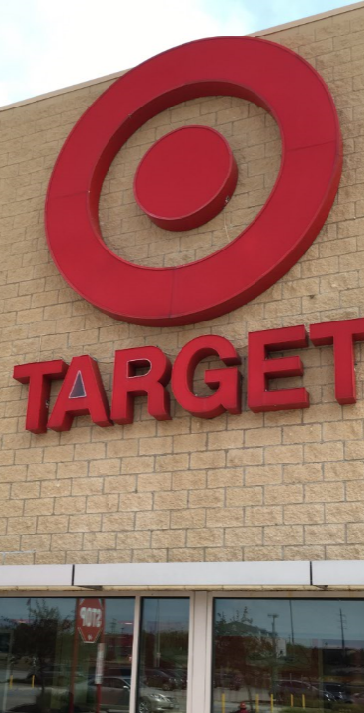
Hypothetical Example:
Best Buy, Amazon, and Target
Target: LIFO

Slide 9
LIFO: Target
Newest units sold first, so units in EI were from BI
Value of ending inventory:
Cost per unit in BI x units in EI | $ 10.00
COGS:
Total cost of units available less EI | $ 50.00
Gross margin (income):
Sales revenue (# of units sold x selling price) | $ 128.00
Less cost of goods sold | 50.00
Gross margin using LIFO | $ 78.00

Slide 10
Question 1
Calculate the number of units sold.

Slide 11
Question 2
Calculate cost of goods sold, cost of ending inventory, and gross margin for Best Buy using the weighted-average inventory costing method.

Slide 12
Question 3
Calculate cost of goods sold, cost of ending inventory, and gross margin for Amazon using the FIFO inventory costing method.

Slide 13
Question 4
Calculate cost of goods sold, cost of ending inventory, and gross margin for Target using the LIFO inventory costing method.

Slide 14
Question 5
If prices are decreasing, would FIFO or LIFO produce the highest income? Explain.

Slide 15
Question 6
Would FIFO or LIFO produce the highest inventory cost on the balance sheet if prices are rising? Explain.

Slide 16
Question Recap
1. Calculate the number of units sold.
2. Calculate cost of goods sold, cost of ending inventory, and gross margin for Best Buy using the weighted-average inventory costing method.
3. Calculate cost of goods sold, cost of ending inventory, and gross margin for Amazon using the FIFO inventory costing method.
4. Calculate cost of goods sold, cost of ending inventory, and gross margin for Target using the LIFO inventory costing method.
5. If prices are decreasing, would FIFO or LIFO produce the highest income? Explain.
6. Would FIFO or LIFO produce the highest inventory cost on the balance sheet if prices are rising? Explain.

Slide 17
For additional news stories to use in the accounting classroom, see the Accounting in the Headlines blog at http://accountingintheheadlines.com/
Questions or comments? Contact Dr. Wendy Tietz at wtietz@kent.edu

