Slide 1
When LoanMax loans cash to individuals with a 25% monthly interest rate, does it have a receivable or a payable AND is it an ethical practice?
Original blog posting (September 20, 2016)

Slide 2
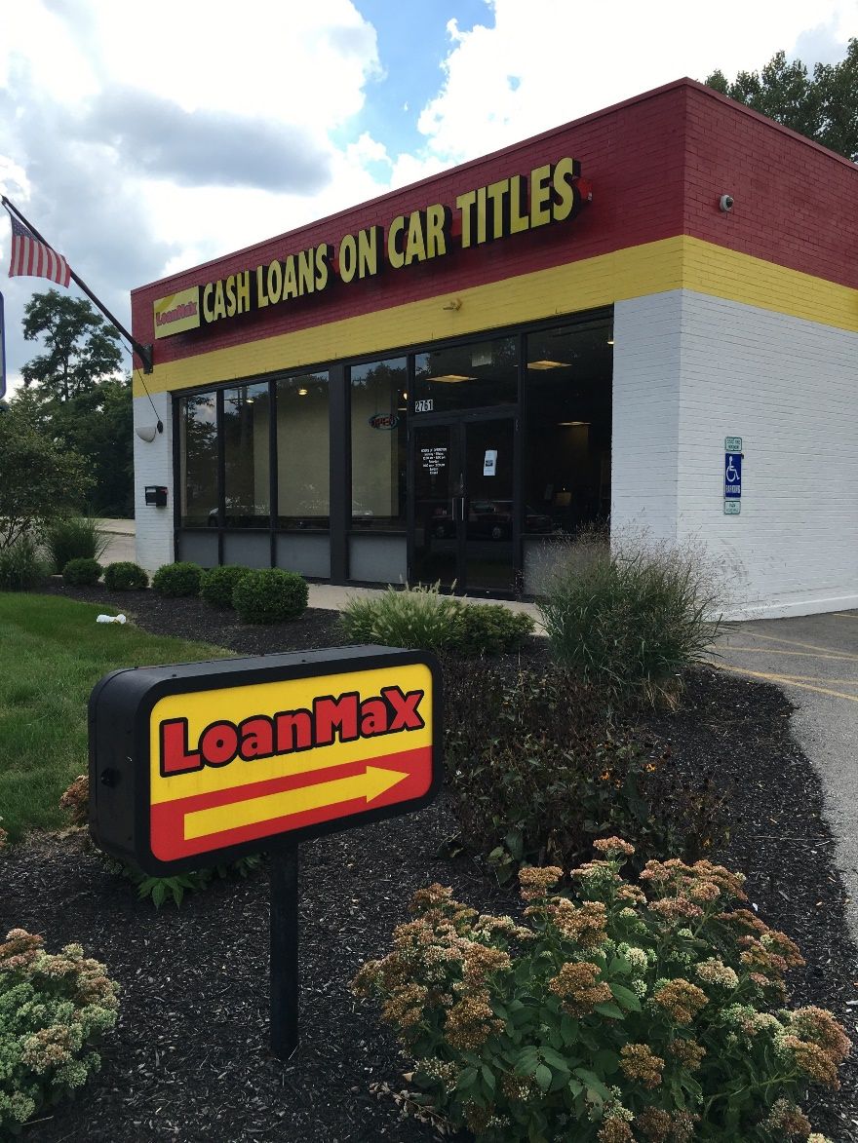
LoanMax
Car title lenders often charge high interest rates to those who can least afford it
  NBC report found average car title loan is for $950 over 10 months, but requires the borrower to pay $2,375 in interest
LoanMax is a consumer lender, gives cash in exchange for car title
Requires borrower to bring in car title, vehicle, and photo ID, no credit check is performed

Slide 3
Question 1
Let’s say an individual borrows $500 cash from a LoanMax. Does LoanMax have a receivable or a payable when it hands over the cash to the borrower?

Slide 4
Question 2
When LoanMax disburses the cash at the time of borrowing, how are its assets, liabilities, and equity impacted?

Slide 5
Question 3
What approximate annual interest rate is LoanMax charging if it charges 25% per month?

Slide 6
Question 4
Do you think the car title loan process is ethical? Explain your point of view.

Slide 7
Question Recap
1. Let’s say an individual borrows $500 cash from a LoanMax. Does LoanMax have a receivable or a payable when it hands over the cash to the borrower?
2. When LoanMax disburses the cash at the time of borrowing, how are its assets, liabilities, and equity impacted?
3. What approximate annual interest rate is LoanMax charging if it charges 25% per month?
4. Do you think the car title loan process is ethical? Explain your point of view.

Slide 8
For additional news stories to use in the accounting classroom, see the Accounting in the Headlines blog at http://accountingintheheadlines.com/
Questions or comments? Contact Dr. Wendy Tietz at wtietz@kent.edu

