Slide 1
Would the cost of the football field constructed on Bristol Motor Speedway for the UT vs VT game be capitalized or expensed?
Original blog posting (September 13, 2016)

Slide 2
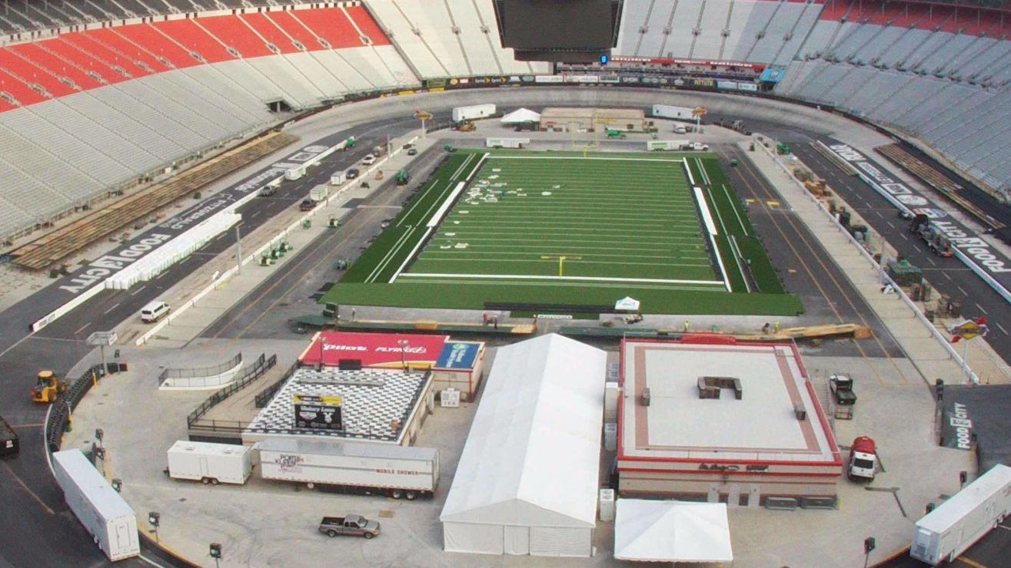
Football Field on Bristol Motor Speedway
09/10/2016: football game played on Bristol Motor Speedway
University of Tennessee versus Virginia Tech
Expected record-breaking attendance of 150,000 people

Slide 3
Football Field on Bristol Motor Speedway
Bristol had 19 days following a NASCAR race to construct the field
  Massive, expensive project, requiring round the clock work
One additional small game would be played there and then the field would be removed

Slide 4
Question 1
Would the cost of the football field be capitalized or expensed by Bristol Motor Sports? Explain.

Slide 5
Question 2
Does the fact that a second game was scheduled to be played on the Bristol football field affect your answer to question 1? Why or why not?

Slide 6
Question Recap
1. Would the cost of the football field be capitalized or expensed by Bristol Motor Sports? Explain.
2. Does the fact that a second game was scheduled to be played on the Bristol football field affect your answer to question 1? Why or why not?

Slide 7
For additional news stories to use in the accounting classroom, see the Accounting in the Headlines blog at http://accountingintheheadlines.com/
Questions or comments? Contact Dr. Wendy Tietz at wtietz@kent.edu

