Slide 1
How many snow cones need to be sold for a Snowie™ snow cone cart to break even?
Original blog posting (August 16, 2016)

Slide 2
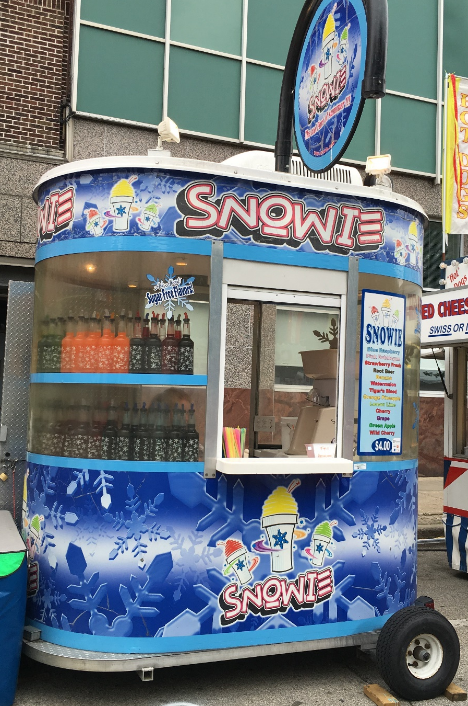
Snowie™ snow cones
Sold at a variety of events and locations across the U.S.
Each 20-ounce snow cone is sold for $4.00
Assumptions:
  Variable cost of each snow cone is $1.00
  Fixed costs per month of operating Snowie™ cart total $1,500

Slide 3
Question 1
What costs are likely to be included as variable costs for each snow cone?

Slide 4
Question 2
What costs are likely to be included as the fixed costs of operating the Snowie™ snow cone cart?

Slide 5
Question 3
Using the hypothetical example given, calculate the number of snow cones that the operator of the Snowie™ snow cone cart has to sell each month to break even.

Slide 6
Question 4
Assume that the operator of the Snowie™ snow cone cart wants to make an operating profit of $1,200 per month (before taxes.) How many snow cones must be sold to achieve this operating profit?

Slide 7
Question 5
Now think about the break even and target profit quantities you just calculated. Do you think these quantities are realistic? Support your answer. Think, for example, about number of days the cart is likely to be operated during a given month and the number of hours the cart is open for business.

Slide 8
Question Recap
What costs are likely to be included as variable costs for each snow cone?
What costs are likely to be included as the fixed costs of operating the Snowie™ snow cone cart?
Using the hypothetical example given, calculate the number of snow cones that the operator of the Snowie™ snow cone cart has to sell each month to break even.
Assume that the operator of the Snowie™ snow cone cart wants to make an operating profit of $1,200 per month (before taxes.) How many snow cones must be sold to achieve this operating profit?
Now think about the break even and target profit quantities you just calculated. Do you think these quantities are realistic? Support your answer. Think, for example, about number of days the cart is likely to be operated during a given month and the number of hours the cart is open for business.

Slide 9
For additional news stories to use in the accounting classroom, see the Accounting in the Headlines blog at http://accountingintheheadlines.com/
Questions or comments? Contact Dr. Wendy Tietz at wtietz@kent.edu

