Slide 1
Revenue Recognition Principles for Introductory Financial Accounting
Wendy TIETZ, PhD, CPA, CMA, Kent State

Slide 2
Summary of revenue recognition changes
Item 1: Five step process
Item 2: New accounts are included in sales returns accrual
Item 3: Sales are recorded net
Item 4: Performance obligations are recorded separately
See page 2

Slide 3
Item 1 Overview: Five step process
  Step 1: Identify the contract(s) with a customer.
  Step 2: Identify the performance obligations in the contract.
  Step 3: Determine the transaction price.
  Step 4: Allocate the transaction price to the performance obligations.
  Step 5: Recognize revenue when, or as, it satisfies each performance obligation.

Slide 4
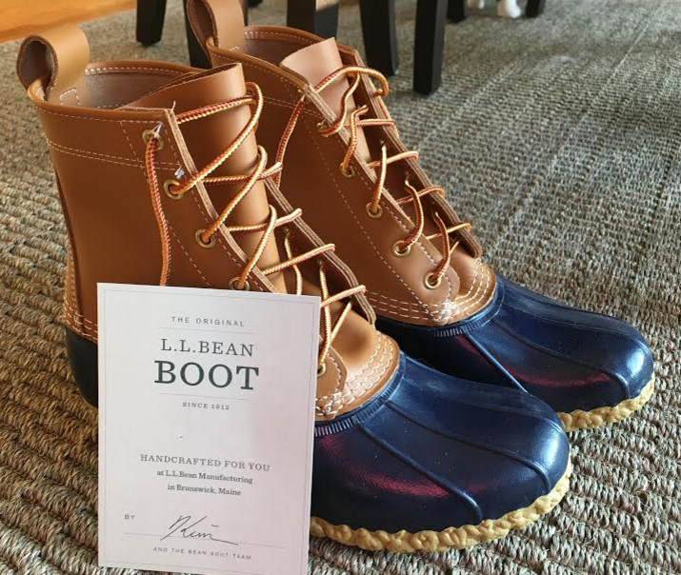

Slide 5
Item 1 Example A: Record individual sale and cost of goods sold
On November 1, 2015, L.L. Bean received an order from Michelle Sylvester for one pair of L.L. Bean 8” boots (aka “duck boots.”) The selling price of the boots is $109. These boots are on backorder; L.L. Bean actually ships the boots to Sylvester on January 2, 2016. Sylvester’s credit card is charged when the boots ship; L.L. Bean treats the credit card sale as cash since it can deposit the credit card receipts into its bank account immediately. Assume that L.L. Bean’s cost of these boots is $44.

Slide 6
  Step 1: Identify the contract(s) with a customer.
    Analysis: Contract is between L.L. Bean and Michelle Sylvester.

Slide 7
  Step 2: Identify the performance obligations in the contract.
    Analysis: L.L. Bean is obligated to deliver boots and Michelle Sylvester is obligated to pay for the boots.

Slide 8
  Step 3: Determine the transaction price.
    Analysis: The selling price is $109.

Slide 9
  Step 4: Allocate the transaction price to the performance obligations.
    Analysis: There is one performance obligation – to ship the boots.

Slide 10
  Step 5: Recognize revenue when, or as, it satisfies each performance obligation.
    Analysis: When L.L. Bean ships the boots on January 2, 2016, its performance obligation is satisfied.

Slide 11
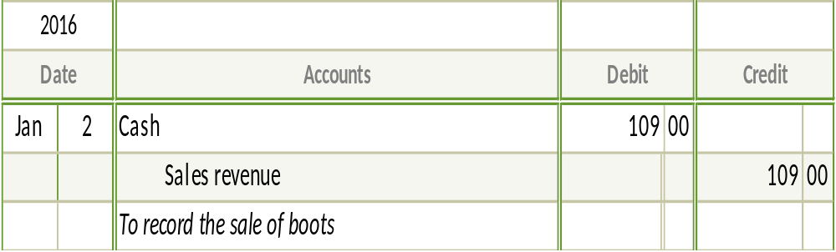
Journal entry 1: Journalize the sale of these boots. Include the date on the journal entry.

Slide 12
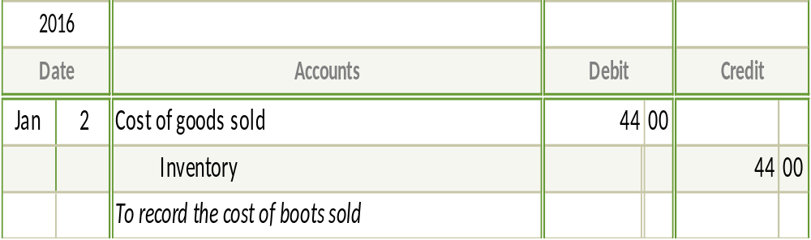
Journal entry 2: Journalize the cost of the boots sold.

Slide 13
Item 1 Example B: Record monthly sales and cost of goods sold
During the month of January 2016, assume that L.L. Bean’s total boot sales are $140,000. All sales are cash sales. The cost of the boots sold was $56,000.

Slide 14
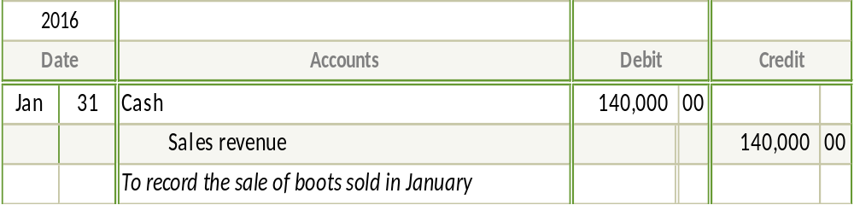
Journal entry 1: Record the January sales of the boots on January 31.

Slide 15
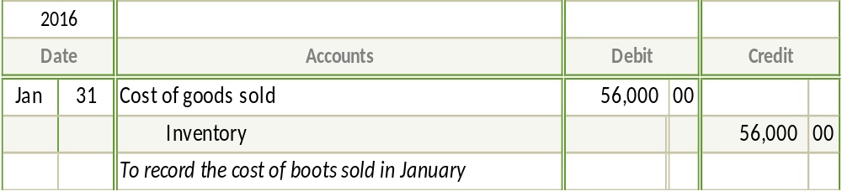
Journal entry 2: Record the January cost of the boots sold on January 31.

Slide 16
Item 2 Example C: Adjusting entry for sales returns estimate
L.L. Bean offers a 100% satisfaction guarantee. Assume that L.L. Bean experiences a 10% return rate.

Slide 17
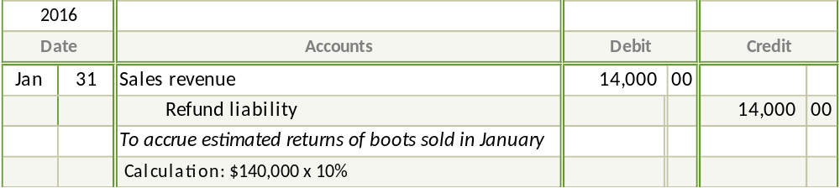
Journal entry 1: Make the adjusting entry for January to reflect the estimated refunds for the January boots sales of $140,000.

Slide 18
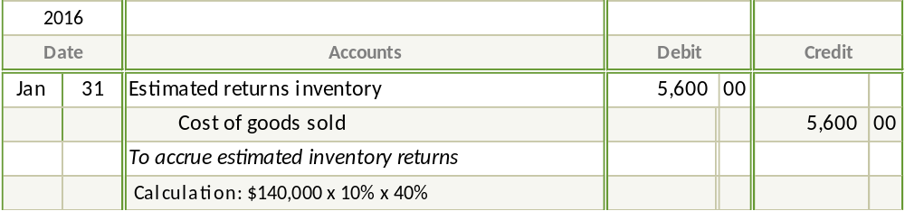
Journal entry 2: Make the adjusting entry to record the cost of estimated returns for January. Use a COGS of 40% of sales.

Slide 19
Item 2 Example D: Return of merchandise
Now assume that Michelle Sylvester returns the L.L. Bean boots on January 10, 2016 (she had received the boots in early January) for a full refund of $109.

Slide 20
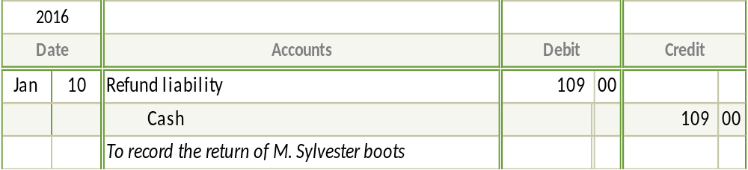
Journal entry 1: Record the return of the boots by Sylvester.

Slide 21
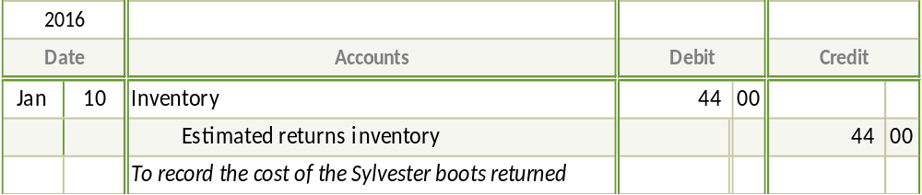
Journal entry 2: Record the cost of the boots returned by Sylvester.

Slide 22
Item 3 Example E: Sell merchandise with sales discount and expect customer to take the discount; payment in discount period
Now assume that Stonecreek Outfitters is an authorized reseller of L.L. Bean boots.

Slide 23
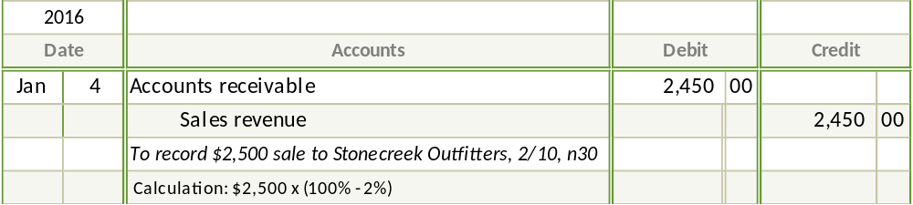
Journal entry 1: On January 4, 2016, L.L. Bean receives an order from Stonecreek for $2,500 and ships same day. Terms are 2/10, net 30.

Slide 24
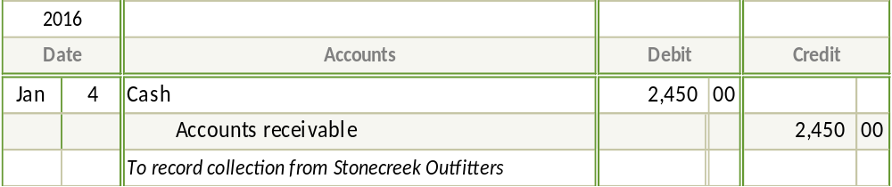
Journal entry 2: On January 12, 2016, Stonecreek pays its invoice to L.L. Bean.

Slide 25
Item 3 Example F: Sell merchandise with sales discount and expect the customer to take the discount; payment NOT in discount period
Now assume that Wild Mountain Sports is an authorized reseller of L.L. Bean boots.

Slide 26
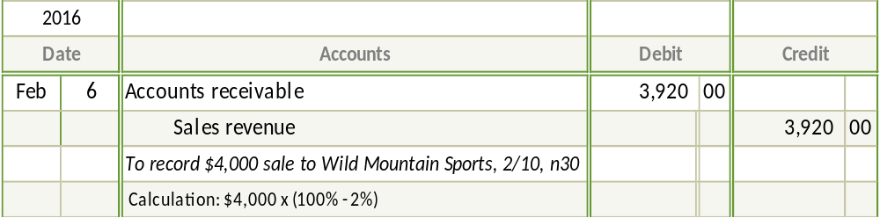
Journal entry 1: On February 6, 2016, L.L. Bean receives an order from Wild Mountain for $4,000 and ships same day. Terms are 2/10, net 30.

Slide 27
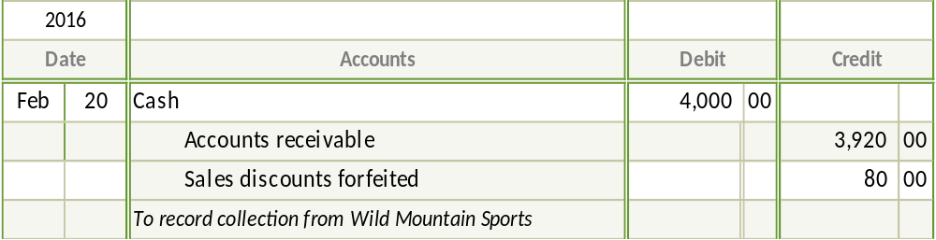
Journal entry 2: On February 20, 2016, Wild Mountain pays its invoice to L.L. Bean.

Slide 28
Item 4 Example G: Sell items that include two performance obligations
On March 10, 2016, L.L. Bean sells one pair of L.L. Bean 8” boots (aka “duck boots”) to Dana Smith in its Lyndhurst, Ohio, store. The selling price of the boots is $109; Smith pays cash at the time of sale. During the month of March, L.L. Bean is running a promotion that awards $20 in L.L. Bean Dollars for every $100 spent in its stores. Accordingly, Smith receives $20 in L.L. Bean Dollars at the time of purchase. These L.L. Bean Dollars can be used the same as cash at any future date at any L.L. Bean store or its Website.

Slide 29
  Step 1: Identify the contract(s) with a customer.
    Analysis: Contract is between L.L. Bean and Dana Smith.

Slide 30
  Step 2: Identify the performance obligations in the contract.
    Analysis: L.L. Bean is obligated to hand over the boots now and $20 of merchandise in the future. Dana Smith is obligated to pay for the boots at the point of purchase.

Slide 31
  Step 3: Determine the transaction price.
    Analysis: The selling price is $109.

Slide 32
  Step 4: Allocate the transaction price to the performance obligations.
    Analysis: The purchase price of $109 needs to be allocated between the boots and the $20 L.L. Bean Dollars. $89 will be allocated to the purchase price of the boots and $20 will be allocated to the L.L. Bean Dollars (unearned revenue.)

Slide 33
  Step 5: Recognize revenue when, or as, it satisfies each performance obligation.
    Analysis: Analysis: $89 is recognized at the point of sale. The $20 L.L. Bean Dollars (unearned revenue) will be recognized when Smith uses the $20 L.L. Bean Dollars to purchase something in the future.

Slide 34
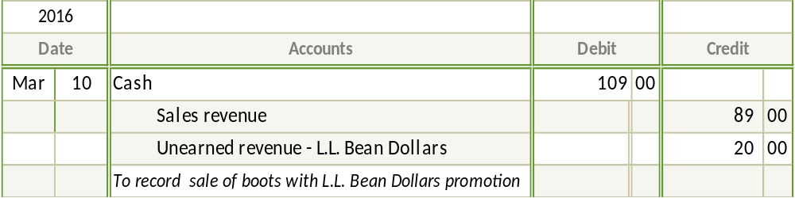
Journal entry: Journalize the sale of these boots. (Do not make the COGS entry.)

Slide 35
Item 4 Example H: Recognize use of L.L. Bean Dollars
Now let’s say that Smith uses the $20 in L.L. Bean Dollars on June 5, 2016, when she purchases a shirt at the L.L. Bean Store in Lyndhurst for a selling price of $43. She pays cash of $23 at the point of purchase.

Slide 36
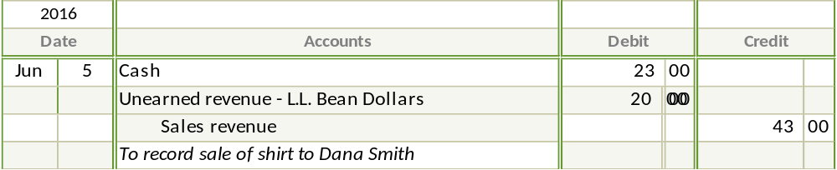
Journal entry: Journalize the sale of the shirt and the use of the L.L. Bean Dollars by Smith. (Do not make the COGS entry.)

Slide 37

Class materials
Go to Accounting in the Headlines blog
https://accountingintheheadlines.com/
Includes student handouts and solutions from today
wtietz@kent.edu | @WendyTietz

