Slide 1
Would the costs related to Cedar Point’s Valravn roller coaster be expensed or capitalized?
Original blog posting (August 30, 2016)

Slide 2
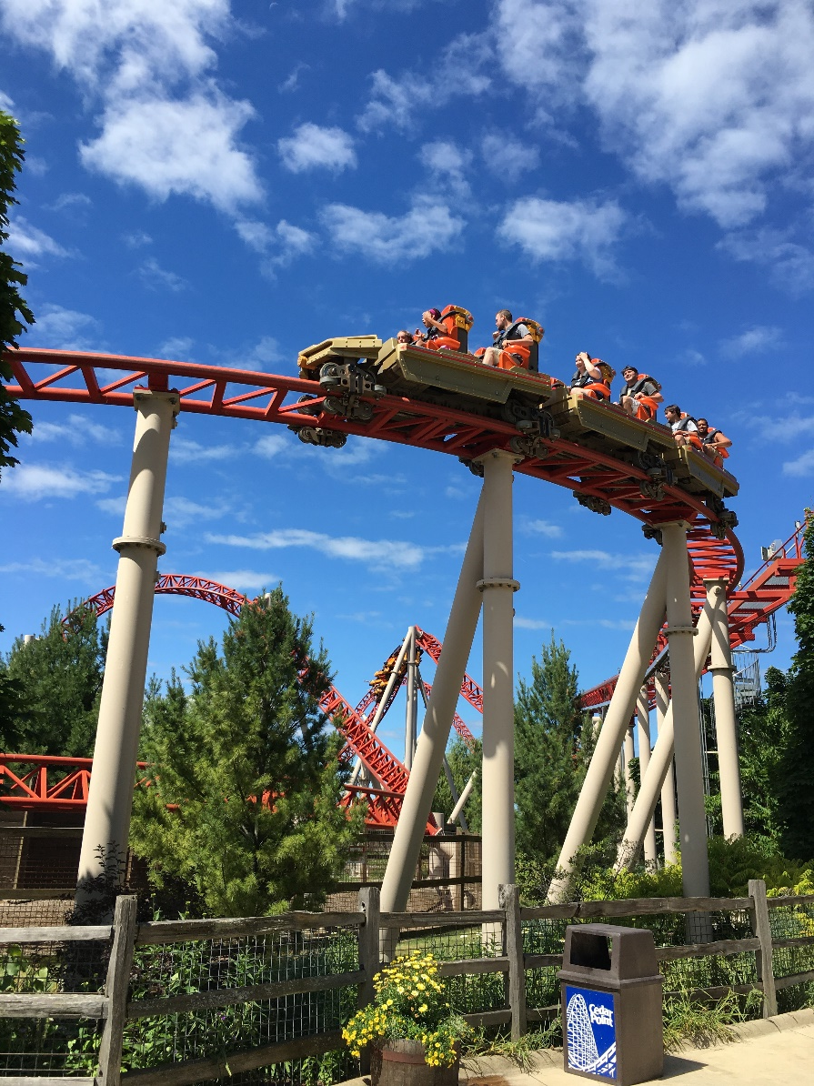
Cedar Point Valravn
Cedar Point is an amusement park in Ohio with over 18 roller coasters
2016: added Valravn with a height of 223 feet and speed of 75 miles per hour
  Officially tallest, fastest, and longest dive coaster in the world
More than 20 Ohio companies involved in construction, with estimated costs of $20 – $25 million

Slide 3
Question 1
On which financial statement would the estimated cost of construction of Valravn be found? How would this construction cost be classified (i.e., what account)?

Slide 4
Question 2
Would the cost of removing the Good Time Theatre and the Turnpike Cars be expensed or capitalized? Explain.

Slide 5
Question 3
Would the cost paid to the firm that designed Valravn be expensed or capitalized? Why?

Slide 6
Question 4
Would the wages of the employees who perform daily maintenance on Valravn throughout the summer operating season be expensed or capitalized? Explain.

Slide 7
Question 5
Would the cost of annual maintenance performed on Valravn during the winter season when the park is closed be expensed or capitalized? Explain.

Slide 8
Question Recap
1. On which financial statement would the estimated cost of construction of Valravn be found? How would this construction cost be classified (i.e., what account)?
2. Would the cost of removing the Good Time Theatre and the Turnpike Cars be expensed or capitalized? Explain.
3. Would the cost paid to the firm that designed Valravn be expensed or capitalized? Why?
4. Would the wages of the employees who perform daily maintenance on Valravn throughout the summer operating season be expensed or capitalized? Explain.
5. Would the cost of annual maintenance performed on Valravn during the winter season when the park is closed be expensed or capitalized? Explain.

Slide 9
For additional news stories to use in the accounting classroom, see the Accounting in the Headlines blog at http://accountingintheheadlines.com/
Questions or comments? Contact Dr. Wendy Tietz at wtietz@kent.edu

