Slide 1
What internal controls might have prevented the $1.4 million kickback fraud scheme at Utz?
Original blog posting (July 5, 2016)

Slide 2
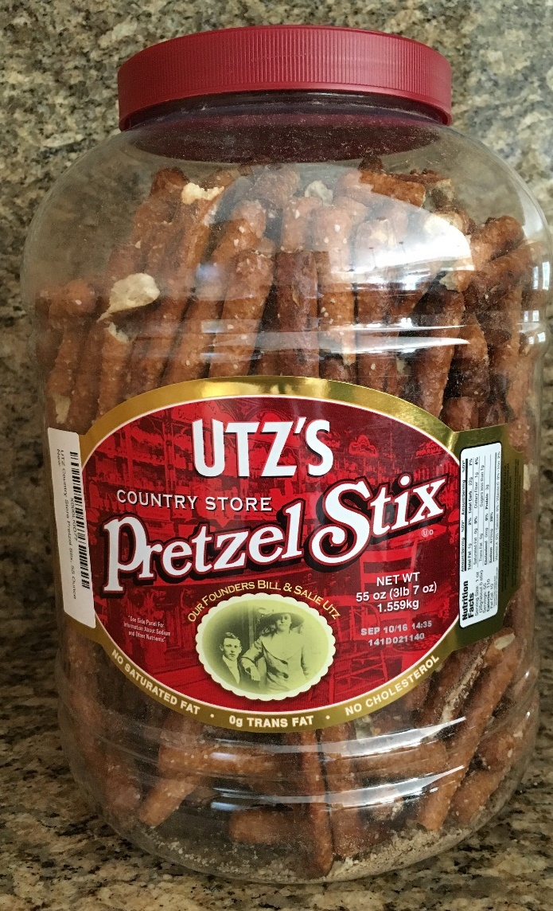
Utz Kickback Fraud Scheme
Snack food company based in Hanover, PA
Victim of $1.4 million fraud scheme perpetrated by Kevin Myers, director of purchasing at Utz, and Jonathan Haas, supplier
Haas submitted false invoices to Utz which Meyers would approve for payment then the two men split the money

Slide 3
Question 1
What is an internal control that could have prevented this fraud scheme?

Slide 4
Question 2
Why do you think the government filed plea agreements for the two men?

Slide 5
Question Recap
What is an internal control that could have prevented this fraud scheme?
Why do you think the government filed plea agreements for the two men?

Slide 6
For additional news stories to use in the accounting classroom, see the Accounting in the Headlines blog at http://accountingintheheadlines.com/
Questions or comments? Contact Dr. Wendy Tietz at wtietz@kent.edu

