Slide 1
Would Yogurt Vi use job costing or process costing in calculating the cost of a customer's cup of frozen yogurt and toppings?
Original blog posting (June 23, 2016)

Slide 2
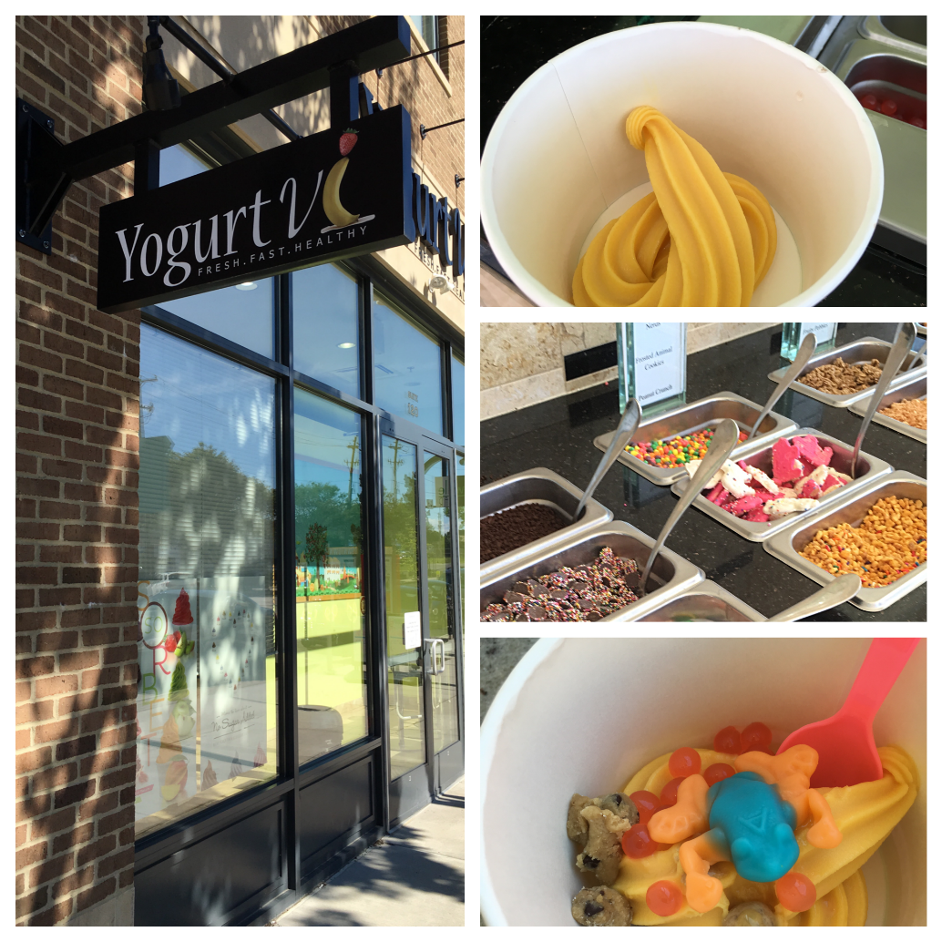
Yogurt Vi
Frozen yogurt chain
Self-serve frozen yogurt machines and toppings bars
Cup of yogurt with toppings is weighed and customer is charged $0.48 per ounce

Slide 3
Question 1
Do you think that Yogurt Vi pays the same amount to its suppliers for each of the toppings? For example, is it probable that fresh strawberries cost the exact same amount as M&M candies? Do you think the toppings would cost the same amount as the frozen yogurt mix that is put into the soft-serve machines?

Slide 4
Question 2
From a technical viewpoint, do you think Yogurt Vi would use a job costing system or a process costing system for calculating the cost of each customer’s order? Explain.

Slide 5
Question 3
From a practical standpoint, do you think Yogurt Vi would use a job costing system or a process costing system for calculating the cost of each customer’s order? Explain.

Slide 6
Question Recap
Do you think that Yogurt Vi pays the same amount to its suppliers for each of the toppings? For example, is it probable that fresh strawberries cost the exact same amount as M&M candies? Do you think the toppings would cost the same amount as the frozen yogurt mix that is put into the soft-serve machines?
From a technical viewpoint, do you think Yogurt Vi would use a job costing system or a process costing system for calculating the cost of each customer’s order? Explain.
From a practical standpoint, do you think Yogurt Vi would use a job costing system or a process costing system for calculating the cost of each customer’s order? Explain.

Slide 7
For additional news stories to use in the accounting classroom, see the Accounting in the Headlines blog at http://accountingintheheadlines.com/
Questions or comments? Contact Dr. Wendy Tietz at wtietz@kent.edu

