Slide 1
What internal controls might have prevented a SeaWorld guest relations supervisor from voiding tickets and pocketing more than $116,000?
Original blog posting (June 21, 2016)

Slide 2
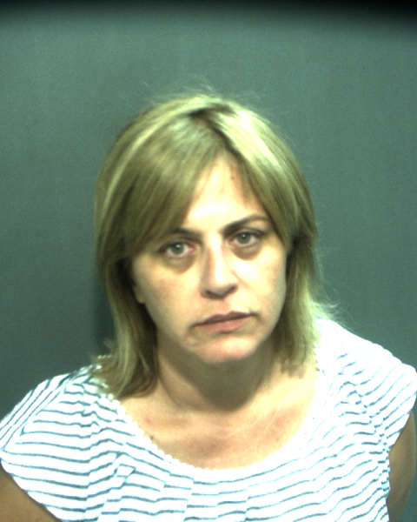
SeaWorld Internal Controls
Guest relations supervisor, Lisa Olivardia, would void tickets and pocket the cash
Estimated she stole $55,000 to $75,000 a year from 2013 – 2015
Voided transactions were triple the rate of her co-workers
Allegedly stole cash from co-workers’ cash drawers as well
Employee for almost 30 years prior to being caught

Slide 3
Question 1
What internal controls might have prevented this theft?

Slide 4
Question 2
Why might Sea World have not had these controls in place?

Slide 5
Question Recap
What internal controls might have prevented this theft?
Why might Sea World have not had these controls in place?

Slide 6
For additional news stories to use in the accounting classroom, see the Accounting in the Headlines blog at http://accountingintheheadlines.com/
Questions or comments? Contact Dr. Wendy Tietz at wtietz@kent.edu

