Slide 1
How would the Pittsburgh Steelers classify the purchase of robots to use for tackle practice?
Original blog posting (June 1, 2016)

Slide 2
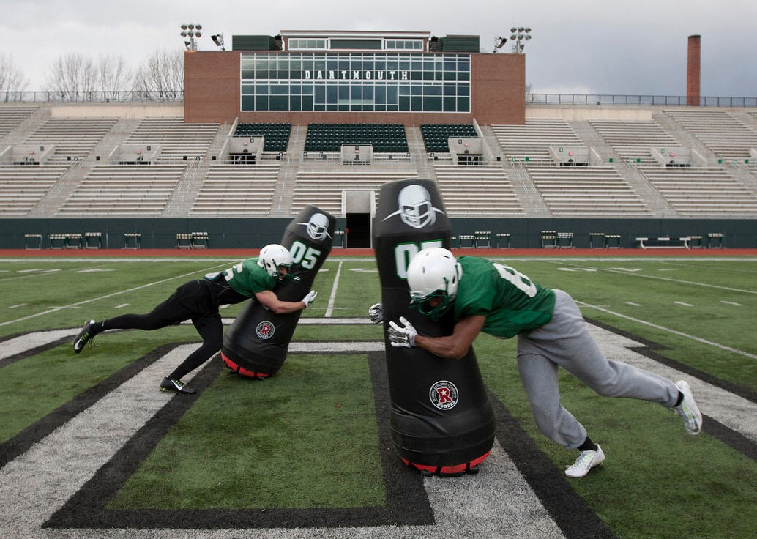
Copyright: Mobile Virtual Player
Copyright: Mobile Virtual Player

Slide 3
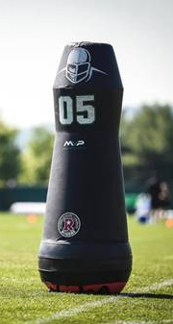
Mobile Virtual Player tackle robot
Mobile Virtual Player (MVP) dummy is in testing now
Pittsburgh Steelers are one team testing it
Players tackle foam-padded MVP robots during practice to reduce injury to players
Battery-operated
Top speed is 18 miles per hour
Copyright: Mobile Virtual Player

Slide 4
Question 1
Assume that the Steelers decide to purchase several of these MVP robots. Would the organization expense or capitalize this purchase? Why?

Slide 5
Question 2
What if, after a year, routine maintenance needed to be performed on the MVP robots. For example, the foam padding might need to be replaced and the software updated. Would the Steelers expense or capitalize the cost of the routine maintenance? Why?

Slide 6
Question 3
Assume now that the MVP robots are estimated by the manufacturer to last for five years. Now support that a team purchases a robot and definitely plans at the time of purchase to use it for three years only and then upgrade to the newest tackle robot model available at that future time. Will that team depreciate the original robot using a five year estimated useful life or a three year estimated useful life? Explain.

Slide 7
Question Recap
Assume that the Steelers decide to purchase several of these MVP robots. Would the organization expense or capitalize this purchase? Why?
What if, after a year, routine maintenance needed to be performed on the MVP robots. For example, the foam padding might need to be replaced and the software updated. Would the Steelers expense or capitalize the cost of the routine maintenance? Why?
Assume now that the MVP robots are estimated by the manufacturer to last for five years. Now support that a team purchases a robot and definitely plans at the time of purchase to use it for three years only and then upgrade to the newest tackle robot model available at that future time. Will that team depreciate the original robot using a five year estimated useful life or a three year estimated useful life? Explain.

Slide 8
For additional news stories to use in the accounting classroom, see the Accounting in the Headlines blog at http://accountingintheheadlines.com/
Questions or comments? Contact Dr. Wendy Tietz at wtietz@kent.edu

