Slide 1
What would the payback period be for a robotic arm used by McDonald's for food preparation?
Original blog posting (June 14, 2016)

Slide 2
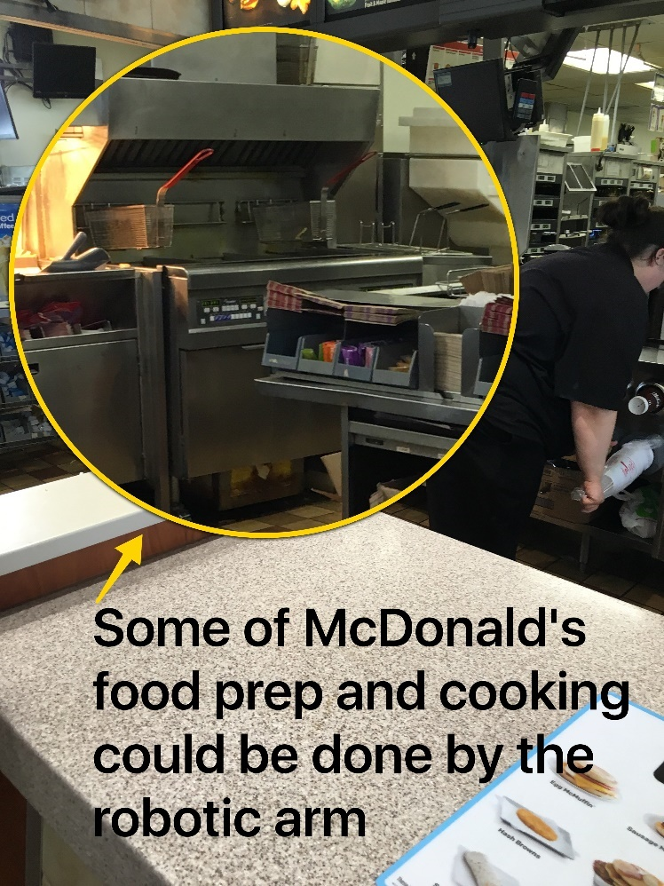
McDonalds Food Prep Robot
Variety of robots were featured at the 2016 National Restaurant Show
Currently, there is an on-going debate in the U.S. to raise minimum wage to $15 per hour
Former McDonald’s USA CEO, Ed Rensi, said purchasing a $35,000 robotic arm would be cheaper than paying fast food workers $15 for food prep tasks

Slide 3
McDonalds Food Prep Robot
For this example, make the following assumptions:
 | For the cost of the hourly workers, use a total wage rate of $18 per hour to reflect payroll taxes (payroll taxes can add 15% or more to the hourly wage rate.)
b. | Assume that freight and installation for the robot’s initial placement in a McDonald’s will be a one-time cost of $5,000.
c. | The robot will require periodic service. Assume an annual service contract is required that costs 10% of the original cost plus installation of the robot per year.
d. | Assume that the robot will replace 10 employee hours per day, 360 days per year (the robot will not, at least initially, be as versatile as a person and cannot fully eliminate all food prep workers at this point.)
e. | Electricity and supplies consumed by the robot will be assumed to be $1,500 per year.

Slide 4
Question 1
What would the payback period be on a McDonald’s robot used for food preparation?

Slide 5
Question 2
What qualitative factors would McDonald’s need to consider when deciding whether to purchase robots to replace some of its food preparation workers?

Slide 6
Question 3
Given the payback period, would net present value (NPV) or internal rate of return (IRR) be likely to be useful tools for analyzing this decision? Support your response.

Slide 7
Question Recap
What would the payback period be on a McDonald’s robot used for food preparation?
What qualitative factors would McDonald’s need to consider when deciding whether to purchase robots to replace some of its food preparation workers?
Given the payback period, would net present value (NPV) or internal rate of return (IRR) be likely to be useful tools for analyzing this decision? Support your response.

Slide 8
For additional news stories to use in the accounting classroom, see the Accounting in the Headlines blog at http://accountingintheheadlines.com/
Questions or comments? Contact Dr. Wendy Tietz at wtietz@kent.edu

