Slide 1
Which is healthier from a cash flow standpoint, Sears or Wal-Mart?
Original blog posting (April 26, 2016)

Slide 2
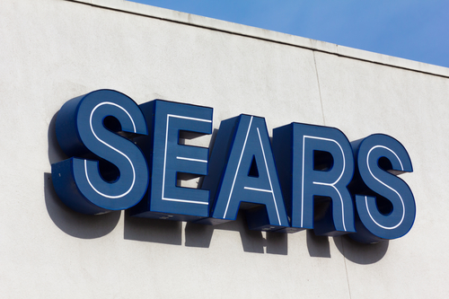
Sears Holding Corporation
In April 2016, Sears Holding Corporation (SHLD) announced it would be closing 68 Kmart and 10 Sears stores
Sears’ fiscal year-end is the Saturday closest to January 31

Slide 3
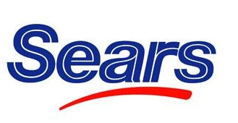
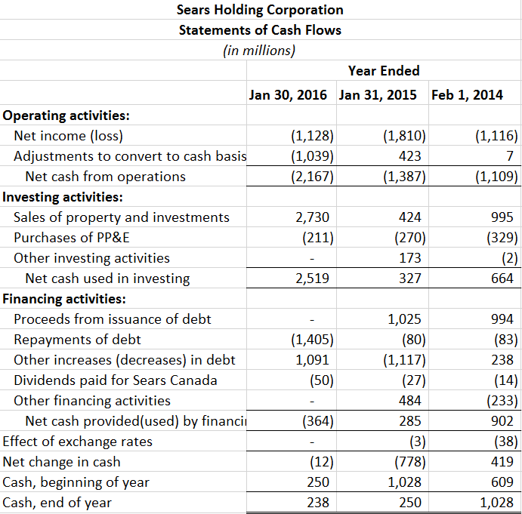
Sears

Slide 4
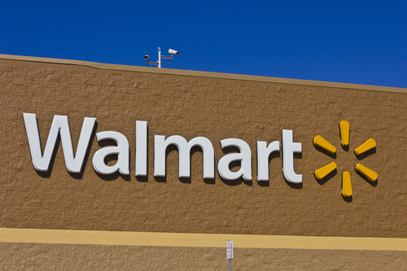
Wal-Mart Stores, Inc.
In January 2016, Wal-Mart Stores, Inc. (WMT) announced that it would be closing 269 stores worldwide
Like Sears, this was done to try to increase profitability
Fiscal year-end is January 31

Slide 5
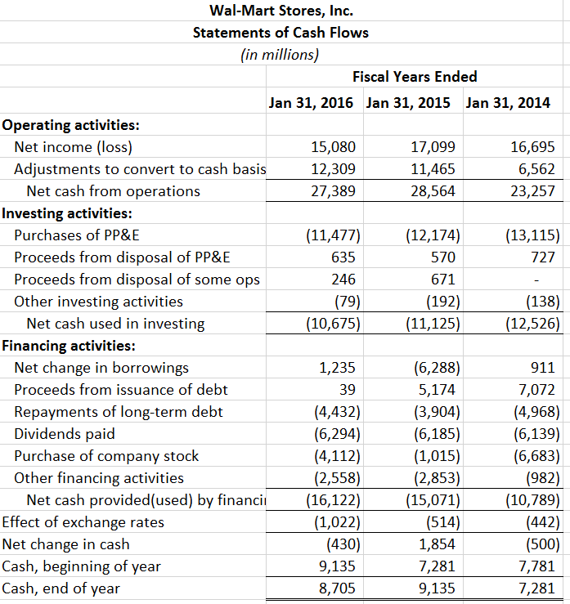

Wal-Mart

Slide 6
Question 1
Using its statements of cash flows, answer the following questions about Sears:
  Is Sears generating cash from its operations?
  Describe what investing activities Sears has been involved in over the past three years. Are investing activities an overall source or use of funds for Sears?
  What financing activities has Sears been undertaking in the past three years? Has it been paying dividends to its common stockholders? (Note: Sears Canada is a holding that does not represent Sears common stockholders.)
  How will the closure of the Kmart and Sears stores impact the 2016 statement of cash flows?

Slide 7
Question 2
Using its statements of cash flows, answer the following questions about Wal-Mart:
  Is Wal-Mart generating cash from its operations?
  Describe what investing activities Wal-Mart has been involved in over the past three years. Are investing activities an overall source or use of funds for Wal-Mart?
  What financing activities has Wal-Mart been undertaking in the past three years? Has it been paying dividends to its common stockholders?
  How will the closure of the Wal-Mart stores impact the 2016 statement of cash flows?

Slide 8
Question 3
Judging from the statements of cash flows, which company, Sears or Wal-Mart, is healthier?

Slide 9
Question 4
Why do you think Sears and Wal-Mart would have fiscal year-ends around January 31 rather than using a calendar year-end of December 31?

Slide 10
Question Recap
Using its statements of cash flows, answer the following questions about Sears.
  Is Sears generating cash from its operations?
  Describe what investing activities Sears has been involved in over the past three years. Are investing activities an overall source or use of funds for Sears?
  What financing activities has Sears been undertaking in the past three years? Has it been paying dividends to its common stockholders? (Note: Sears Canada is a holding that does not represent Sears common stockholders.)
  How will the closure of the Kmart and Sears stores impact the 2016 statement of cash flows?
Using its statements of cash flows, answer the same questions from above about Wal-Mart.
Judging from the statements of cash flows, which company, Sears or Wal-Mart, is healthier?
Why do you think Sears and Wal-Mart would have fiscal year-ends around January 31 rather than using a calendar year-end of December 31?

Slide 11
For additional news stories to use in the accounting classroom, see the Accounting in the Headlines blog at http://accountingintheheadlines.com/
Questions or comments? Contact Dr. Wendy Tietz at wtietz@kent.edu

