Slide 1
What quality costs will Mars incur from its recall of Snickers candy bars?
Original blog posting (March 8, 2016)

Slide 2
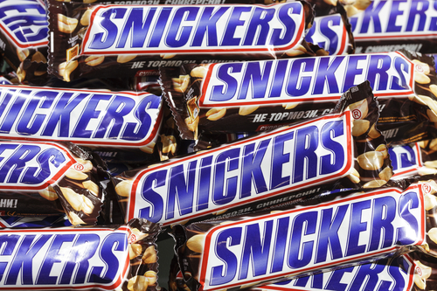
Mars
US chocolate maker and one of world’s largest privately-held companies
Issued voluntary recall of Snickers, Milky Way, and other candies manufactured in Dutch factory between Dec. 2015 – Jan. 2016
Potentially millions of candy bars and tens of millions of dollars
Photographer: depositphotos_19398829-usersam2007

Slide 3
Question 1
Prior to the recall, what specific costs of quality could Mars incur in the design, production, and distribution of its candy bars? Again, use your imagination.

Slide 4
Question 2
What specific costs were the analysts referring to when estimating that this recall could cost Mars “tens of millions of dollars?” List as many costs as you can imagine might be incurred related to the recall.

Slide 5
Question 3
Classify the costs you listed for Mars (both pre-recall and post-recall) by type of quality cost: prevention, appraisal, internal failure, or external failure.

Slide 6
Question Recap
Prior to the recall, what specific costs of quality could Mars incur in the design, production, and distribution of its candy bars? Again, use your imagination.
What specific costs was the analysts referring to when estimating that this recall could cost Mars “tens of millions of dollars?” List as many costs as you can imagine might be incurred related to the recall.
Classify the costs you listed for Mars (both pre-recall and post-recall) by type of quality cost: prevention, appraisal, internal failure, or external failure.

Slide 7
For additional news stories to use in the accounting classroom, see the Accounting in the Headlines blog at http://accountingintheheadlines.com/
Questions or comments? Contact Dr. Wendy Tietz at wtietz@kent.edu

