Slide 1
How will Black Squirrel Rentals use the relative sales value method to allocate the purchase price of a rental property it purchased?
Original blog posting (March 22, 2016)

Slide 2
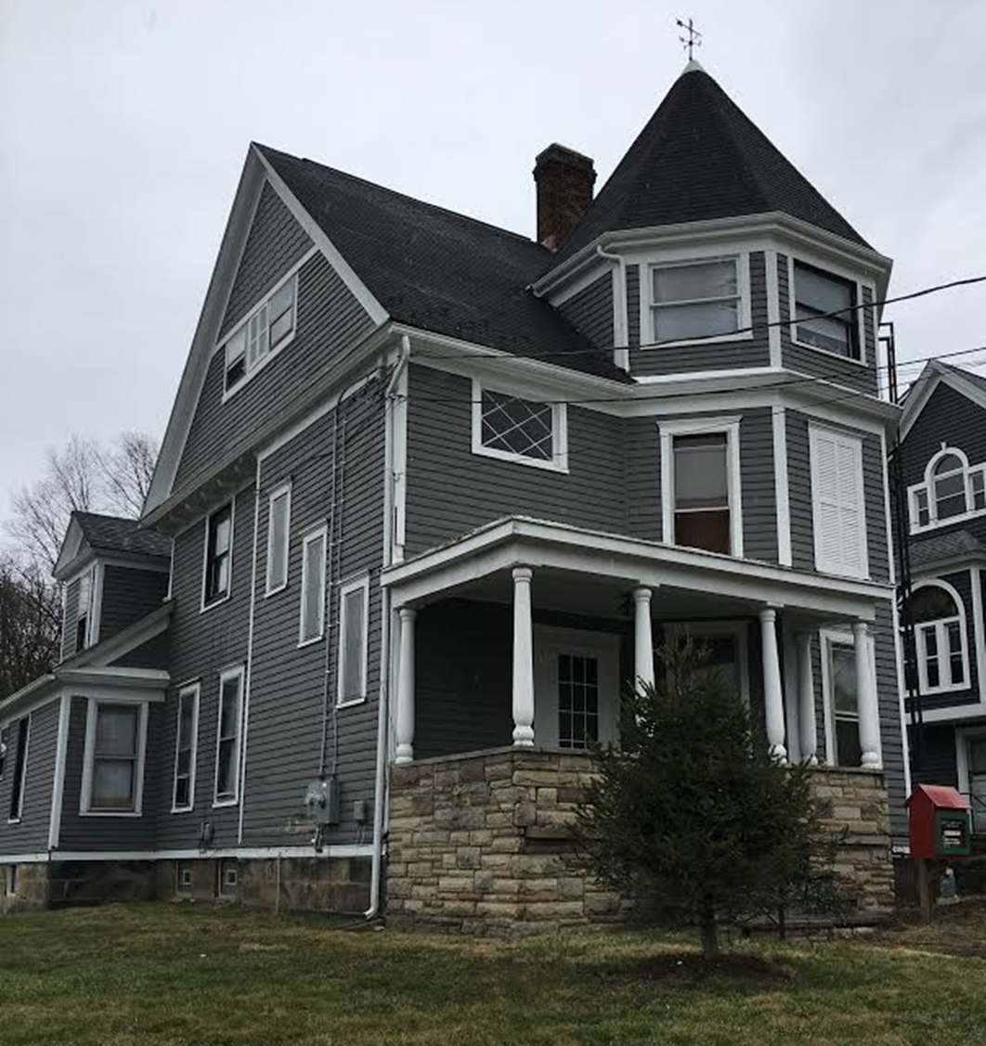
Black Squirrel Rentals
Real estate company located in Kent, OH
Real estate purchased for $290,000 on 4/3/15
Assume: Land (.436 acres) appraised at $60,000
Assume: Building appraised at $240,000
Need to allocate $290,000 to two things purchased: land and building

Slide 3
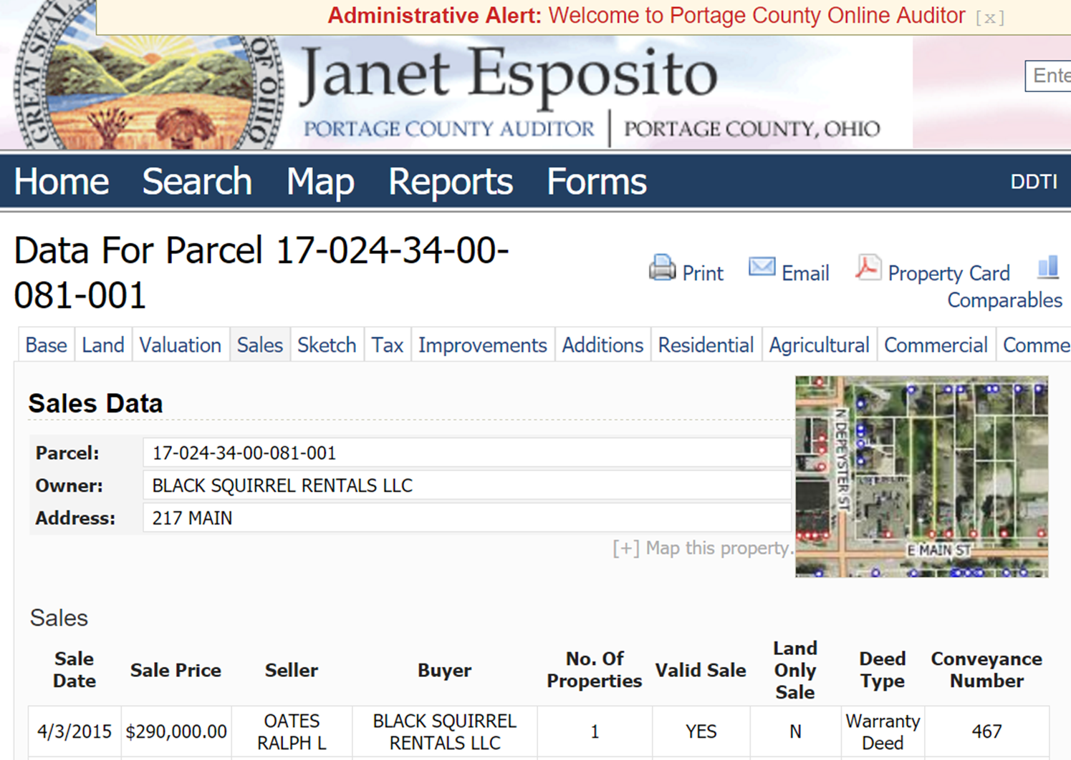

Slide 4
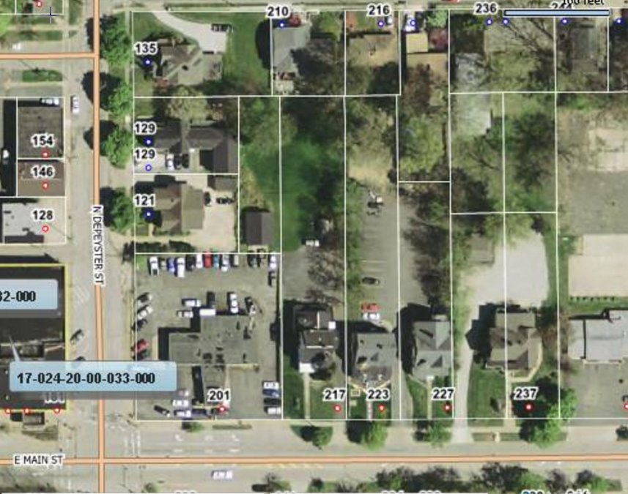

Slide 5
Question 1
What is the total appraised value of the house plus the land?

Slide 6
Question 2
Why is there a difference between the purchase price and the total appraised value?

Slide 7
Question 3
What is the relative sales method? Why is it important to allocate the purchase price to the house and to the land individually?

Slide 8
Question 4
Of the total appraised value, what percentage is the house? What percentage is the land?

Slide 9
Question 5
How much of the purchase price should be allocated to the house? How much should be allocated to the land?

Slide 10
Question Recap
1. What is the total appraised value of the house plus the land?
2. Why is there a difference between the purchase price and the total appraised value?
3. What is the relative sales method? Why is it important to allocate the purchase price to the house and to the land individually?
4. Of the total appraised value, what percentage is the house? What percentage is the land?
5. How much of the purchase price should be allocated to the house? How much should be allocated to the land?

Slide 11
For additional news stories to use in the accounting classroom, see the Accounting in the Headlines blog at http://accountingintheheadlines.com/
Questions or comments? Contact Dr. Wendy Tietz at wtietz@kent.edu

