Slide 1
How would an investor classify an Anheuser-Busch 5 year, 2.65% bond it intends to hold to maturity?
Original blog posting (March 29, 2016)

Slide 2
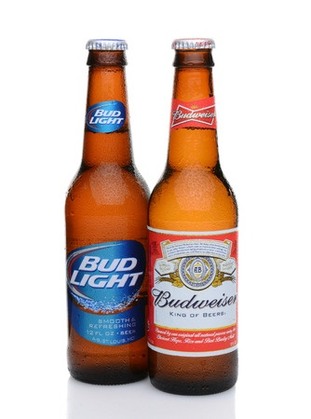
Anheuser-Busch
Largest beer company in the world with over 200 brands
Currently buying SABMiller
Issued $46 billion of bonds to finance the acquisition
Maturity dates range from 3-30 years
Coupon rates from 1.9% up to 4.915%
Photo Copyright: <a href='http://www.123rf.com/profile_scukrov'>scukrov / 123RF Stock Photo</a>

Slide 3
Question 1
Does Smythe Industries have an investment or a bond payable?

Slide 4
Question 2
Does Anheuser-Busch have an investment or a bond payable?

Slide 5
Question 3
Will this bond appear on Smythe’s income statement or balance sheet? How will this bond be classified on that statement?

Slide 6
Question 4
Will Smythe have interest revenue or interest expense on this bond? How much would the semi-annual interest payment be?

Slide 7
Question Recap
Does Smythe Industries have an investment or a bond payable?
Does Anheuser-Busch have an investment or a bond payable?
Will this bond appear on Smythe’s income statement or balance sheet? How will this bond be classified on that statement?
Will Smythe have interest revenue or interest expense on this bond? How much would the semi-annual interest payment be?

Slide 8
For additional news stories to use in the accounting classroom, see the Accounting in the Headlines blog at http://accountingintheheadlines.com/
Questions or comments? Contact Dr. Wendy Tietz at wtietz@kent.edu

