Slide 1
When the chocolate used in Cadbury Creme Eggs was changed to a less expensive chocolate, what variances would have been impacted?
Original blog posting (February 23, 2016)

Slide 2
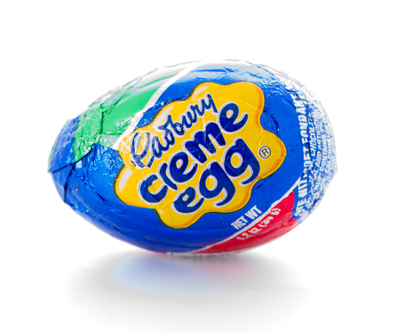
Cadbury Creme Eggs
Cadbury Eggs are produced in Canada and the United Kingdom
In 2015, Cadbury replaced its Cadbury Dairy Milk chocolate with “standard cocoa mix chocolate”
Sales have fallen more than $14 million since the change
Photographer: http://depositphotos.com/home.html

Slide 3
Question 1
Assume that Cadbury uses standard costing in its manufacturing operations. What variance would have been impacted by the decrease in the cost of the chocolate used in the Cadbury eggs? Would this variance have been favorable or unfavorable? What position or department within Cadbury would have been responsible for that variance?

Slide 4
Question 2
What variance would have been impacted by the drop in sales revenue from the recipe change? Would this variance have been favorable or unfavorable? What position or department within Cadbury would have been responsible for that variance?

Slide 5
Question 3
Do you think the change in recipe was a good move for Cadbury? Explain.

Slide 6
Question Recap
Assume that Cadbury uses standard costing in its manufacturing operations. What variance would have been impacted by the decrease in the cost of the chocolate used in the Cadbury eggs? Would this variance have been favorable or unfavorable? What position or department within Cadbury would have been responsible for that variance?
What variance would have been impacted by the drop in sales revenue from the recipe change? Would this variance have been favorable or unfavorable? What position or department within Cadbury would have been responsible for that variance?
Do you think the change in recipe was a good move for Cadbury? Explain.

Slide 7
For additional news stories to use in the accounting classroom, see the Accounting in the Headlines blog at http://accountingintheheadlines.com/
Questions or comments? Contact Dr. Wendy Tietz at wtietz@kent.edu

