Slide 1
Would the owner of the PNC Arena where the Carolina Hurricanes play hockey be better off financially if the arena were to shut down?
Original blog posting (February 16, 2016)

Slide 2
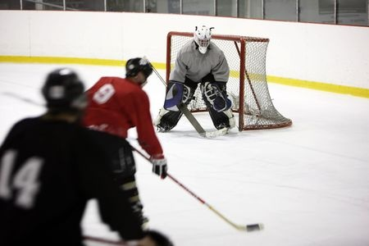
Carolina Hurricanes & PNC Arena
Gale Force Holdings LP owns the Carolina Hurricanes, a professional hockey team, and PNC Arena where the Hurricanes play
A recent article claims the owner lost $1.3 million in the year ended June 2015 operating the PNC Arena
Gale Force has leased PNC Arena through 2024
Photographer: http://www.123rf.com/profile_dreef

Slide 3
Gale Force Holdings LP
Consolidated Statement of Operations
Year ended June 30, 2015
Revenues | $ 23,055,725
Operating expenses | 22,748,229
Operating income (loss) | $ 307,496
Depreciation & Amortization | (1,707,607)
Other Income/Non-Arena Related | 105,864
NET INCOME (LOSS) | $ (1,294,247)

Slide 4
Question 1
Does “Depreciation & Amortization” affect cash (ignore income taxes)?

Slide 5
Question 2
The title of the Forbes news article stated “Carolina Hurricanes Owner Lost $1.3 Million Operating PNC Arena.” Did the owner actually incur out-of-pocket expenses causing the loss?

Slide 6
Question 3
If the Carolina Hurricanes Owner were to suddenly shut down the PNC Arena, would he be better or worse off financially? Explain. Assume that there is no alternate use for the PNC Arena.

Slide 7
Question Recap
Does “Depreciation & Amortization” affect cash (ignore income taxes)?
The title of the Forbes news article stated “Carolina Hurricanes Owner Lost $1.3 Million Operating PNC Arena.” Did the owner actually incur out-of-pocket expenses causing the loss?
If the Carolina Hurricanes Owner were to suddenly shut down the PNC Arena, would he be better or worse off financially? Explain. Assume that there is no alternate use for the PNC Arena.

Slide 8
For additional news stories to use in the accounting classroom, see the Accounting in the Headlines blog at http://accountingintheheadlines.com/
Questions or comments? Contact Dr. Wendy Tietz at wtietz@kent.edu

