Slide 1
How would the breakeven sales of Cafe Edison, a New York City diner, have been affected by a rent increase?
Original blog posting (January 12, 2016)

Slide 2
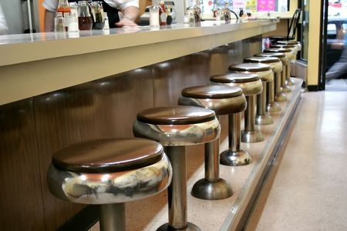
Cafe Edison, a New York City Diner
Recently, several traditional diners in New York City have closed, including Cafe Edison
Rent for small businesses has been rising due to increasing real estate costs
Cafe Edison was open an average of 21 hours per day and served a variety of traditional diner foods
Photographer: http://www.123rf.com/profile_Moustyk

Slide 3
Question 1
How much, on average, did Cafe Edison make on a menu item?

Slide 4
Question 2
How many menu items would Cafe Edison need to sell per month to cover its fixed costs before the rent increase? Per day (assume 30 days per month)? Per hour?

Slide 5
Question 3
How many menu items would Cafe Edison need to sell per month to cover the rent increase itself? Per day (assume 30 days per month)? Per hour?

Slide 6
Question 4
Would it have been realistic for Cafe Edison to continue operating once the rent increase took effect?

Slide 7
Question Recap
How much, on average, did Cafe Edison make on a menu item?
How many menu items would Cafe Edison need to sell per month to cover its fixed costs before the rent increase? Per day (assume 30 days per month)? Per hour?
How many menu items would Cafe Edison need to sell per month to cover the rent increase itself? Per day (assume 30 days per month)? Per hour?
Would it have been realistic for Cafe Edison to continue operating once the rent increase took effect?

Slide 8
For additional news stories to use in the accounting classroom, see the Accounting in the Headlines blog at http://accountingintheheadlines.com/
Questions or comments? Contact Dr. Wendy Tietz at wtietz@kent.edu

