Slide 1
How can a common-size income statement help analysis of Pandora’s results of operations in 2015 compared to 2014?
Original blog posting (November 12, 2015)

Slide 2

Pandora Internet Radio
Pandora Internet Radio is a music streaming service first launched in 2005
Free service: includes advertisements
Pandora One: paid service with no advertisements
Pandora is yet to earn a profit since inception and earnings have been less than expected in 2015
Photographer: http://www.123rf.com/profile_bowie15

Slide 3
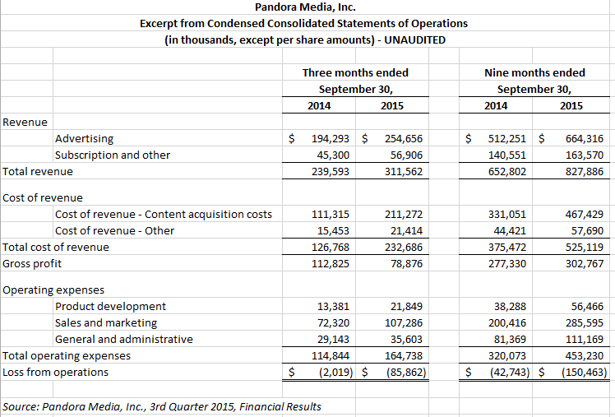
Source: Domino’s

Slide 4
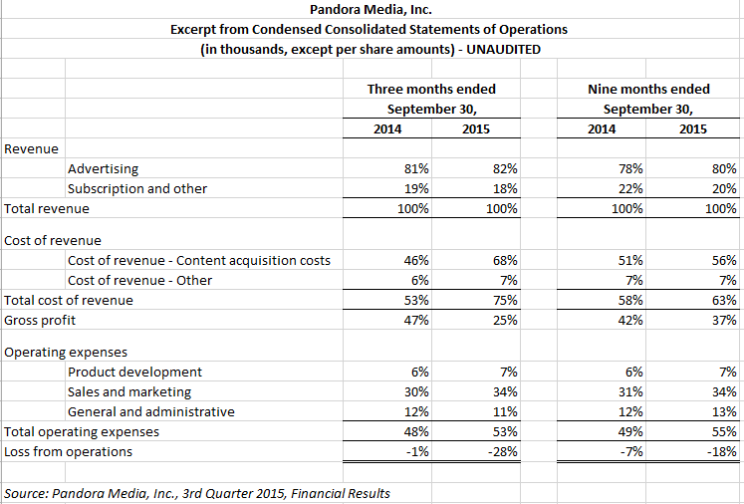

Slide 5
Question 1
Using the statement of operations excerpt in dollars, what can you say about how Pandora is doing in the third quarter of 2015 compared to the third quarter of 2014? What can you say about how Pandora is doing for the nine months ended September 2015 compared to September 2014? Can you tell if the rate of increase is greater for revenues or expenses from 2014 to 2015? Why or why not?

Slide 6
Question 2
Using the statement of operations excerpt in dollars again, why is the loss from operations larger in 2015 than in 2014?

Slide 7
Question 3
Using the common-size statement of operations excerpt, what can you say about how Pandora is doing in the third quarter of 2015 compared to the third quarter of 2014? What can you say about how Pandora is doing for the nine months ended September 2015 compared to September 2014? Is the rate of increase is greater for revenues or expenses from 2014 to 2015?

Slide 8
Question 4
Using the common-size statement of operations excerpt again, why is the loss from operations larger in 2015 than in 2014? Also, what can you say about the mix of advertising revenue versus subscription revenue?

Slide 9
Question 5
Which statement (dollars versus common-size) is more useful for analyzing the financial performance of Pandora in this case? Explain.

Slide 10
Question Recap
Using the statement of operations excerpt in dollars, what can you say about how Pandora is doing in the third quarter of 2015 compared to the third quarter of 2014? What can you say about how Pandora is doing for the nine months ended September 2015 compared to September 2014? Can you tell if the rate of increase is greater for revenues or expenses from 2014 to 2015? Why or why not?
Using the statement of operations excerpt in dollars again, why is the loss from operations larger in 2015 than in 2014?
Using the common-size statement of operations excerpt, what can you say about how Pandora is doing in the third quarter of 2015 compared to the third quarter of 2014? What can you say about how Pandora is doing for the nine months ended September 2015 compared to September 2014? Is the rate of increase is greater for revenues or expenses from 2014 to 2015?
Using the common-size statement of operations excerpt again, why is the loss from operations larger in 2015 than in 2014? Also, what can you say about the mix of advertising revenue versus subscription revenue?
Which statement (dollars versus common-size) is more useful for analyzing the financial performance of Pandora in this case? Explain.

Slide 11
For additional news stories to use in the accounting classroom, see the Accounting in the Headlines blog at http://accountingintheheadlines.com/
Questions or comments? Contact Dr. Wendy Tietz at wtietz@kent.edu

