Slide 1
What type of responsibility center would a Kohl’s Café within the department store be considered?
Original blog posting (November 24, 2015)

Slide 2
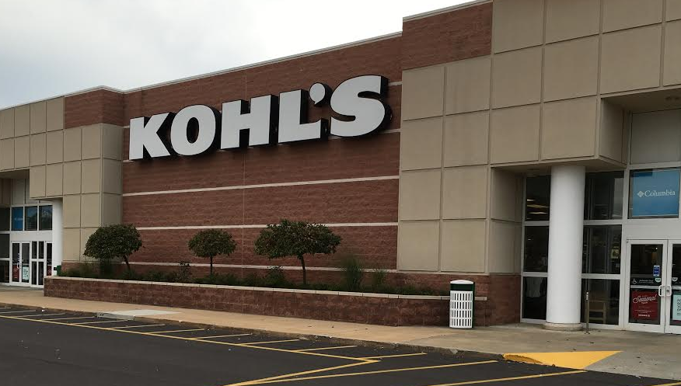
Kohl’s Café
Kohl’s is opening 2 cafés in its stores in Milwaukee, Wisconsin area
Hopes to increase number of shoppers and length of time in store
Will sell Caribou Coffee items and snacks

Slide 3
Question 1
What type of responsibility center would the Kohl’s Café within a given store be (cost center, revenue center, profit center, or investment center)?

Slide 4
Question 2
What costs do you think could be traced directly to a café in a given store?

Slide 5
Question 3
Assume that Kohl’s wants to evaluate the profitability (or performance) of a café within a given store. What, if any, costs should be allocated to the café? Explain your answer.

Slide 6
Question 4
Now assume that Kohl’s wants to evaluate whether the café has been a good investment from the standpoint of having increased overall store sales. What revenues and costs are relevant to this evaluation?

Slide 7
Question 5
Let’s now assume that Kohl’s wants to allocate the net costs of a café to all of the departments within a Kohl’s store (Juniors, Men, Shoes, etc.). Are there any potential issues with allocating the café costs across the store? Explain.

Slide 8
Question Recap
What type of responsibility center would the Kohl’s Café within a given store be (cost center, revenue center, profit center, or investment center)?
What costs do you think could be traced directly to a café in a given store?
Assume that Kohl’s wants to evaluate the profitability (or performance) of a café within a given store. What, if any, costs should be allocated to the café? Explain your answer.
Now assume that Kohl’s wants to evaluate whether the café has been a good investment from the standpoint of having increased overall store sales. What revenues and costs are relevant to this evaluation?
Let’s now assume that Kohl’s wants to allocate the net costs of a café to all of the departments within a Kohl’s store (Juniors, Men, Shoes, etc.). Are there any potential issues with allocating the café costs across the store? Explain.

Slide 9
For additional news stories to use in the accounting classroom, see the Accounting in the Headlines blog at http://accountingintheheadlines.com/
Questions or comments? Contact Dr. Wendy Tietz at wtietz@kent.edu

