Slide 1
Would job order costing or process costing be used by the Smarties Candy Company?
Original blog posting (October 15, 2015)

Slide 2
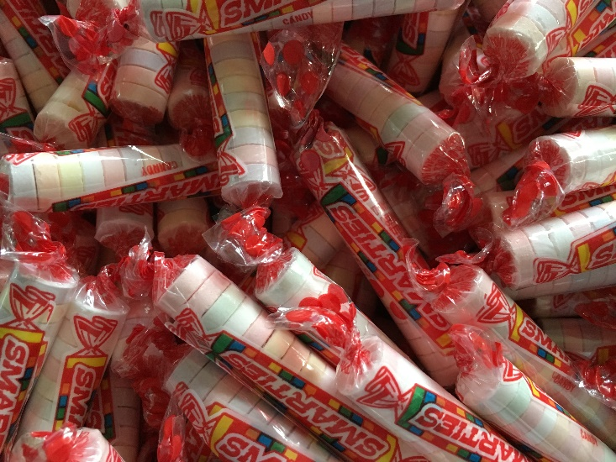
Smarties Candy Company
Main ingredient in Smarties is dextrose (form of sugar)
Smarties are made by color in large batches and then dumped together to be sorted
Previously, 125 rolls could be wrapped per minute; now 200 rolls can be wrapped per minute
Recently introduced new product, Smarties ‘n creme

Slide 3
Smarties Candy Company
Smarties come in six flavors:
  white (orange crème)
  yellow (pineapple)
  pink (cherry)
  green (strawberry)
  purple (grape)
  orange (orange)

Slide 4
Question 1
Give an example of each of the following types of costs at the Smarties Candy Company:
a. Direct material
b. Direct labor
c. Manufacturing overhead
d. Selling and administrative expense

Slide 5
Question 2
Assume that only Smarties candies are made in the New Jersey plant. Do you think the Smarties Candy Company is likely to use job order costing or process costing?

Slide 6
Question 3
If the New Jersey plant begins to produce Smarties ‘n creme in addition to Smarties candy rolls, would this change be likely to affect whether the company uses job order costing or process costing? Why or why not?

Slide 7
Question Recap
Give an example of each of the following types of costs at the Smarties Candy Company:
  a. Direct material
  b. Direct labor
  c. Manufacturing overhead
  d. Selling and administrative expense
Assume that only Smarties candies are made in the New Jersey plant. Do you think the Smarties Candy Company is likely to use job order costing or process costing? Explain.
If the New Jersey plant begins to produce Smarties ‘n creme in addition to Smarties candy rolls, would this change be likely to affect whether the company uses job order costing or process costing? Why or why not?

Slide 8
For additional news stories to use in the accounting classroom, see the Accounting in the Headlines blog at http://accountingintheheadlines.com/
Questions or comments? Contact Dr. Wendy Tietz at wtietz@kent.edu

