Slide 1
What does Ford’s 2015 Form 10-K communicate about its cash flows?
Original blog posting (October 8, 2015)

Slide 2

Ford Motor Company
Ford Motor Company was launched in 1903 with $28,000 cash from twelve investors
By 1919, approximately 50% of cars sold in US were made by Ford
In 2014, Ford had sales of approximately $144 billion

Slide 3
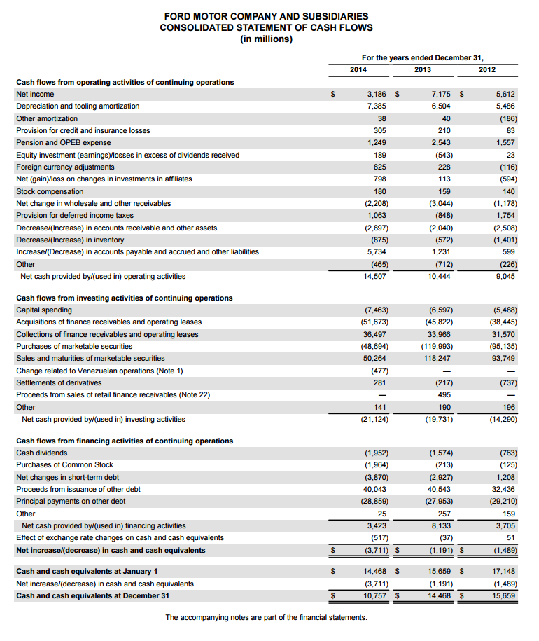
Ford Motor Company Consolidated Statement of Cash Flows (p. FS-6 of Form 10-K) as of December 31, 2014
See next slide for enlarged operating activities slide

Slide 4
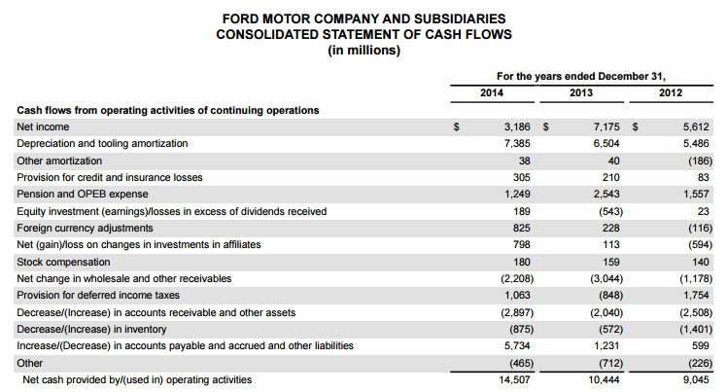
Ford Motor Company Partial Consolidated Statement of Cash Flows (p. FS-6 of Form 10-K) as of December 31, 2014

Slide 5
Ford Motor Company Consolidated Statement of Cash Flows (p. FS-6 of Form 10-K) as of December 31, 2014
See next slide for enlarged investing activities slide

Slide 6
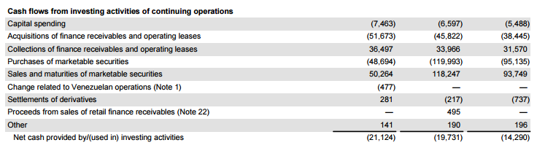
Ford Motor Company Partial Consolidated Statement of Cash Flows (p. FS-6 of Form 10-K) as of December 31, 2014

Slide 7
Ford Motor Company Consolidated Statement of Cash Flows (p. FS-6 of Form 10-K) as of December 31, 2014
See next slide for enlarged financing activities slide

Slide 8
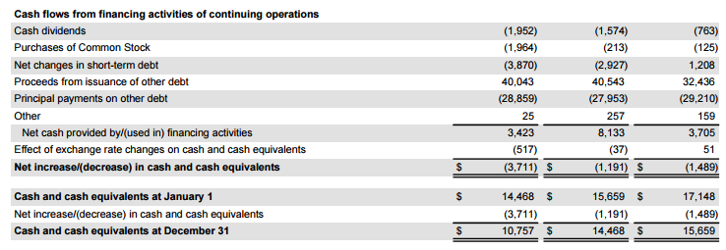
Ford Motor Company Partial Consolidated Statement of Cash Flows (p. FS-6 of Form 10-K) as of December 31, 2014

Slide 9
Question 1
Has Ford Motor Company’s cash balance decreased or increased over the past year?

Slide 10
Question 2
Which type of activity (operating, investing, or financing) is Ford’s largest source of cash inflow? Cash outflow?

Slide 11
Question 3
Which type of activity has changed the most drastically over the past year?

Slide 12
Question 4
What did Ford use the majority of its cash for in 2014?

Slide 13
Question Recap
Has Ford Motor Company’s cash balance decreased or increased over the past year?
Which type of activity (operating, investing, or financing) is Ford’s largest source of cash inflow? Cash outflow?
Which type of activity has changed the most drastically over the past year?
What did Ford use the majority of its cash for in 2014?

Slide 14
For additional news stories to use in the accounting classroom, see the Accounting in the Headlines blog at http://accountingintheheadlines.com/
Questions or comments? Contact Dr. Wendy Tietz at wtietz@kent.edu

