Slide 1
Now that Dyson owns a battery firm, how will the transfer price for batteries used in its vacuums be determined?
Original blog posting (October 22, 2015)

Slide 2
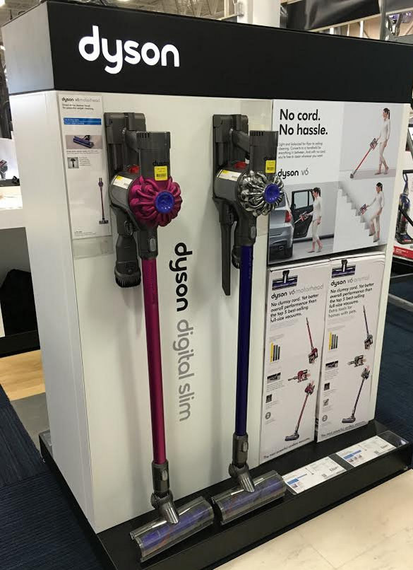
Dyson
Dyson, vacuum cleaner manufacturer, bought Sakti3, Michigan-based battery technology startup firm
Sakti3 manufactures solid-state batteries that last twice as long as current lithium-ion batteries
Potential to be used in hand-held vacuums, a wide variety of household products, and electric vehicles

Slide 3
Question 1
Between Dyson and Sakti3, which is the selling division and which is the buying division with respect to solid-state batteries and transfer pricing?

Slide 4
Question 2
Assume that the battery factory has been built in Michigan and is producing a variety of batteries that can be used both in Dyson’s hand-held vacuums and in other companies’ vacuums. List as many costs as you can imagine that might be incurred by the factory in the production of the batteries.

Slide 5
Question 3
If Dyson uses “cost” as the basis for the internal transfer price for the Sakti3 batteries to be used in its hand-held vacuums, what costs (from the list in the preceding question) do you think should be included in the transfer price? Explain.

Slide 6
Question 4
Do you think that Dyson will determine the internal transfer price for its batteries using market price, negotiated price, or cost? What assumptions do you have to make to answer this question?

Slide 7
Question Recap
Between Dyson and Sakti3, which is the selling division and which is the buying division with respect to solid-state batteries and transfer pricing?
Assume that the battery factory has been built in Michigan and is producing a variety of batteries that can be used both in Dyson’s hand-held vacuums and in other companies’ vacuums. List as many costs as you can imagine that might be incurred by the factory in the production of the batteries.
If Dyson uses “cost” as the basis for the internal transfer price for the Sakti3 batteries to be used in its hand-held vacuums, what costs (from the list in the preceding question) do you think should be included in the transfer price? Explain.
Do you think that Dyson will determine the internal transfer price for its batteries using market price, negotiated price, or cost? What assumptions do you have to make to answer this question?

Slide 8
For additional news stories to use in the accounting classroom, see the Accounting in the Headlines blog at http://accountingintheheadlines.com/
Questions or comments? Contact Dr. Wendy Tietz at wtietz@kent.edu

